Slide 1

Timetable Wiz Advanced Timetable Generation Solution For Educational Institutes
Project-ID 24-25J-238

Slide 2






MEMBERS
Supervisor Mr.Jeewaka Perera
Co-Supervisor Mrs.Sasini Hathurusinghe
Team Leader Weerasinghe K.D.E.I
Team Member Wijayawardhana G.L.C.N.D
Team Member
Udayantha D.M S
Team Member
De Silva K.H.P.N

Slide 3

Presentation Contents
01
Introduction to Research Project
02
Discussion On Research Question & Objectives
03
Explain Research Individual Components
04
Conclusion

Slide 4


Introduction
What is time why is important?
In any organization or in our day-to-day lives time is a valuable resource
Time equals money
Education institutes in particular need effective time management for smooth operations
Schedules drive key activities: assessments , examinations and course schedules
Deadlines are non-negotiable in any critical organization
Timely execution of tasks is a crucial need

Slide 5
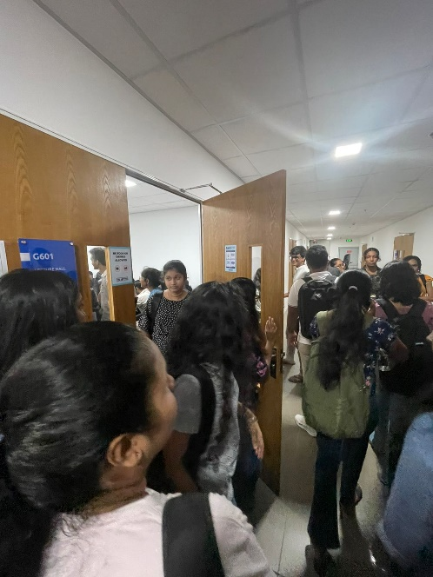
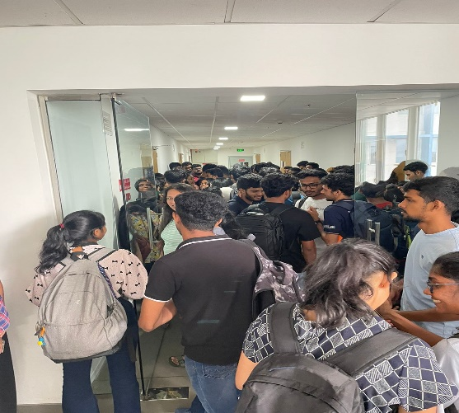
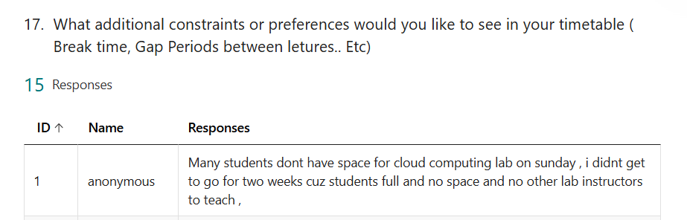
Research Problem
In Outside view Timetables look like a simple
Timetable scheduling is categorized as an NP-Hard problem [2]
Being NP-Hard, Timetable Problem offers multiple constraints
As number Constraints and variables increases, the number of possible schedules grows exponentially making it infeasible to find optimal solution quickly
Unforeseen circumstances would require timetable to adapt in real time
Finite Resources of university must be accommodated efficiently in order meet effective timetable requirements
As Educational institute expand and diversify scalability of scheduling requirement becomes increasingly important
No Students > Allocated Space

Slide 6
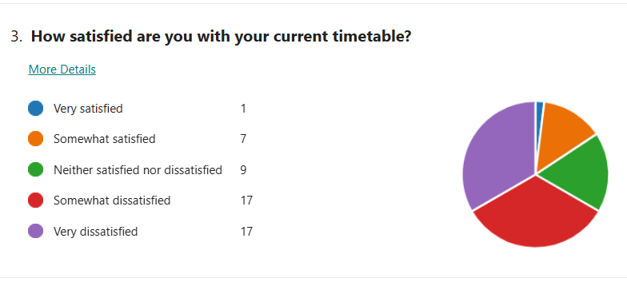
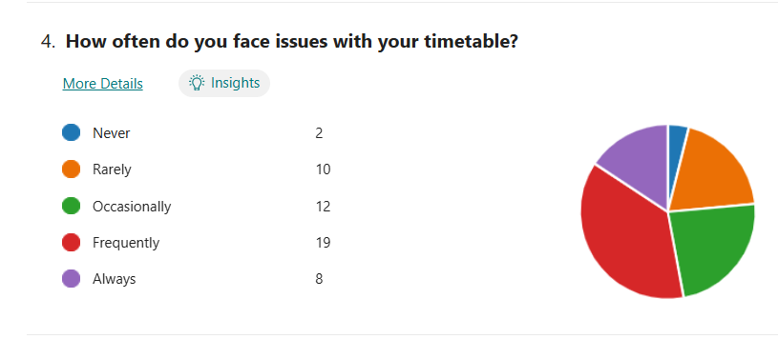
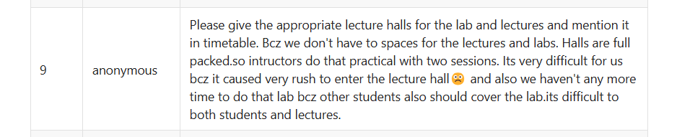
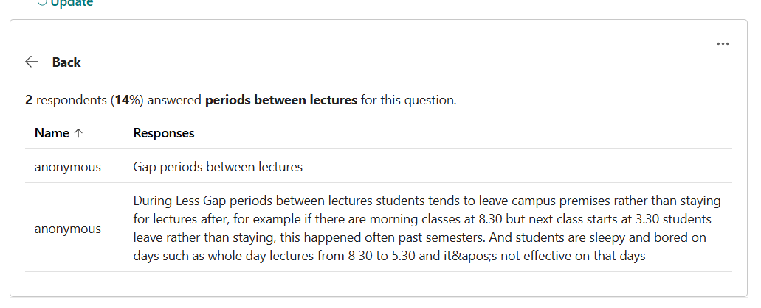
Research Problem Cont.[1]

Slide 7
Main Objective
Research and develop advanced timetabling software that can use optimization techniques such as genetic algorithms, reinforcement learning, and ant colony optimization. Additionally, create an evaluation method to evaluate the algorithms' performance in generating timetables, and provide a user-friendly software to meet current scheduling needs.

Slide 8
Detailed Objetives
Develop Advanced Timetabling Software:
Utilize cutting-edge optimization techniques, including genetic algorithms, reinforcement learning, and colony optimization.
Evaluation Criteria
Research and Develop effective timetable evaluation method for used algorithms
Establish a Research Framework:
Build a strong research foundation that supports future studies in scheduling optimization, contributing to ongoing advancements in the field.
Ensure User-Friendly Experience:
Prioritize a user-centric design by integrating features such as a chatbot interface for easy interaction, Role-Based Access Control (RBAC) for security and authorization calendar integration and Editable Interface for generated timetables for seamless scheduling.

Slide 9
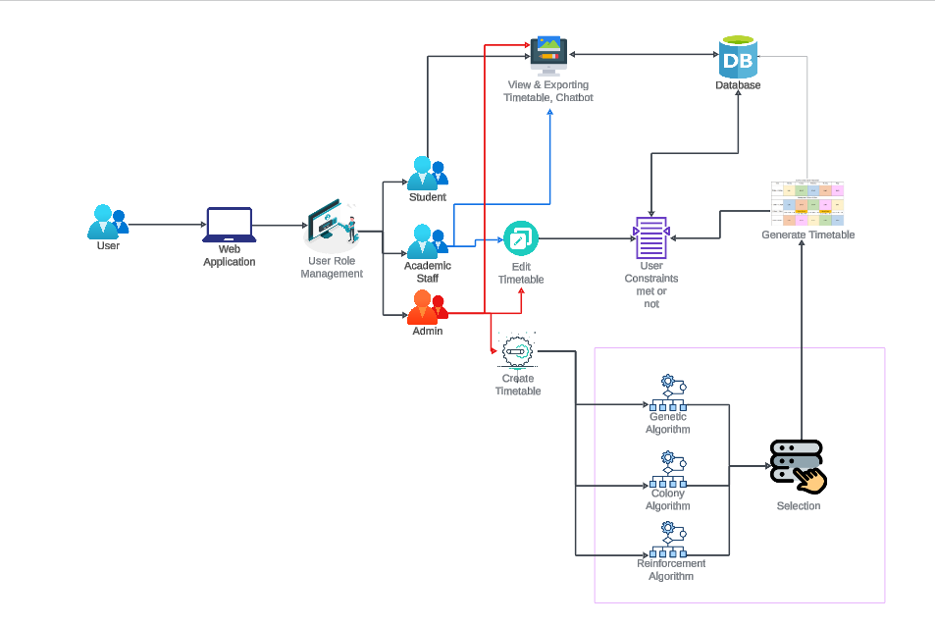
System Overview Diagram

Slide 10
Technologies
Frontend Requirements
Programming Language - JavaScript
Libraries - React, ViteJS
Tools - NodeJS, Tailwind CSS
System Requirements
Operating System - Cross Platform
Software - Python, Node.js, PostgreSQL
Algorithm Requirements
Language - python
Libraries - NumPy, SciPy, ACO, Matplotlib
Environment - Jupiter Notebook
Backend Requirements
Programming Language - Python, FastApI
Database - PostgreSQL

Slide 11

IT21259852| Weerasinghe K.D.E.I
BSc (Hons) Degree in Information Technology (specialization in Information Technology)
IT21259852 | Weerasinghe K.D.E.I | 24-25J-238

Slide 12

Component 01: Research Develop Multi Objective Genetic Algorithms(GA’s) for Timetable Generation and Contribute to RBAC and Export API Development
Introduction
Research Problem
Specific and Sub Objective
Evidences for the Completion
IT21259852 | Weerasinghe K.D.E.I | 24-25J-238

Slide 13
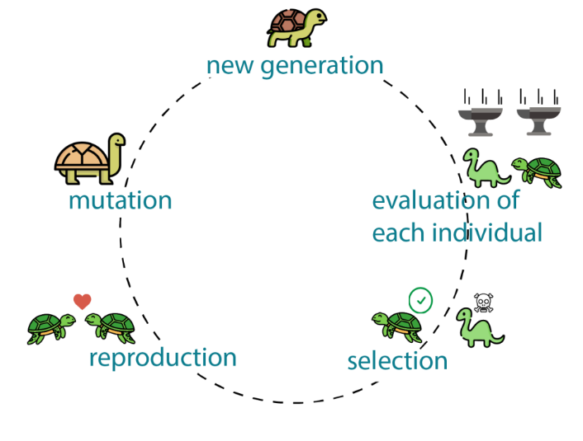

Introduction To Component
Genetic Algorithms are nature inspired method developed under principals of natural selection
GAs are known for their usage in solving Np-Hard problems [1]
GAs are good at navigating through large complex search spaces
Why GA’s -> GAs are good at handling multiple constraints
Flexibility and Adaptability
Develop UI/UX and Implement Role-Base Access Controls in the system
Create Role based Views for timetables and Implement an Export Api to respective institutional Calendars
IT21259852 | Weerasinghe K.D.E.I | 24-25J-238

Slide 14

RESEARCH QUESTION
How To Research and implement multi objective genetic algorithms for fully-fledged timetable generation system
Explore and Evaluate various genetic algorithms to find the most suitable methods for various needs of timetabling
IT21259852 | Weerasinghe K.D.E.I | 24-25J-238

Slide 15

Main Objective And Sub Objective
Main Objective
Research and implement multi objective genetic algorithms to generate timetables and contribute to the full stack development process of scheduling system
Sub Objective
Design genetic algorithm frameworks suitable for scheduling
Identify key areas of improvement of the algorithm
Implement variations of multi objective genetic algorithms such as non-donated sorting genetic algorithms (NSGA –II) and Multi-Objective Evolutionary algorithms based on decomposition (MOEA/D), Strength Pareto (SPEA2)
Implement a method to satisfy both hard and soft constraints
Develop Role base Access on the software
Create features to allow users to view and export their perspective timetables
Integrate an Api that enable users to seamlessly add their schedules to personal institute calendar applications
IT21259852 | Weerasinghe K.D.E.I | 24-25J-238

Slide 16
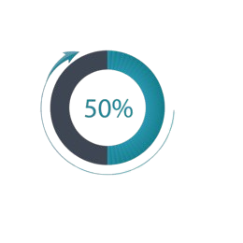
COMPLETION AND FUTURE WORK
Completion | Future Work
Genetic Algorithms (NSGA-II) is Implemented with Hard Constraints | Need to Analyze and Optimize SPEAD2 Algorithms and MOEA/D
Authentication RBAC is Implemented | Create an API to Export to Teams
Frontend Major Views are Done, Login, Registration, Dashboards ,Basic Data Adding | Introduction of Soft-Constraints and Evaluation for the System
IT21208980 | De Silva K.H.P.N | IT21208980

Slide 17
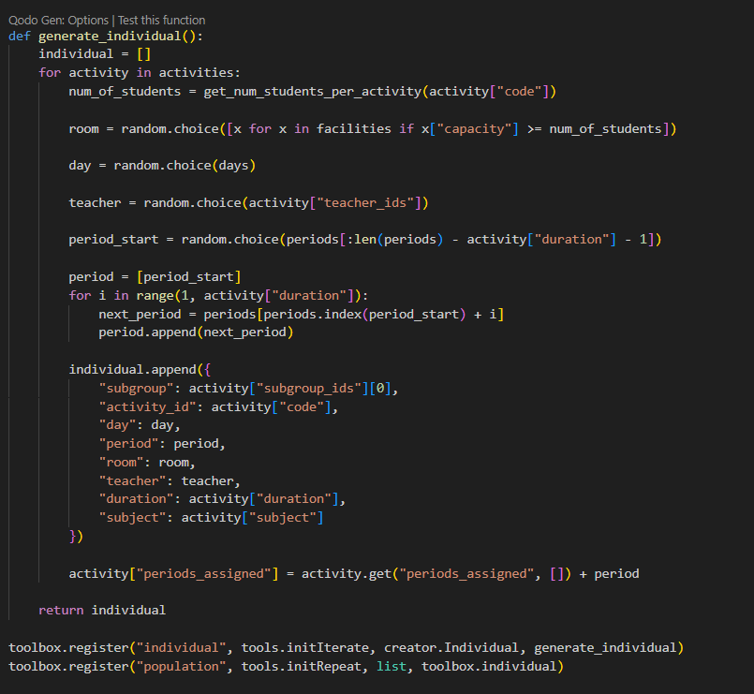
Evidences of Work Done
Generate Individual Function for Genetic Algorithms

Slide 18
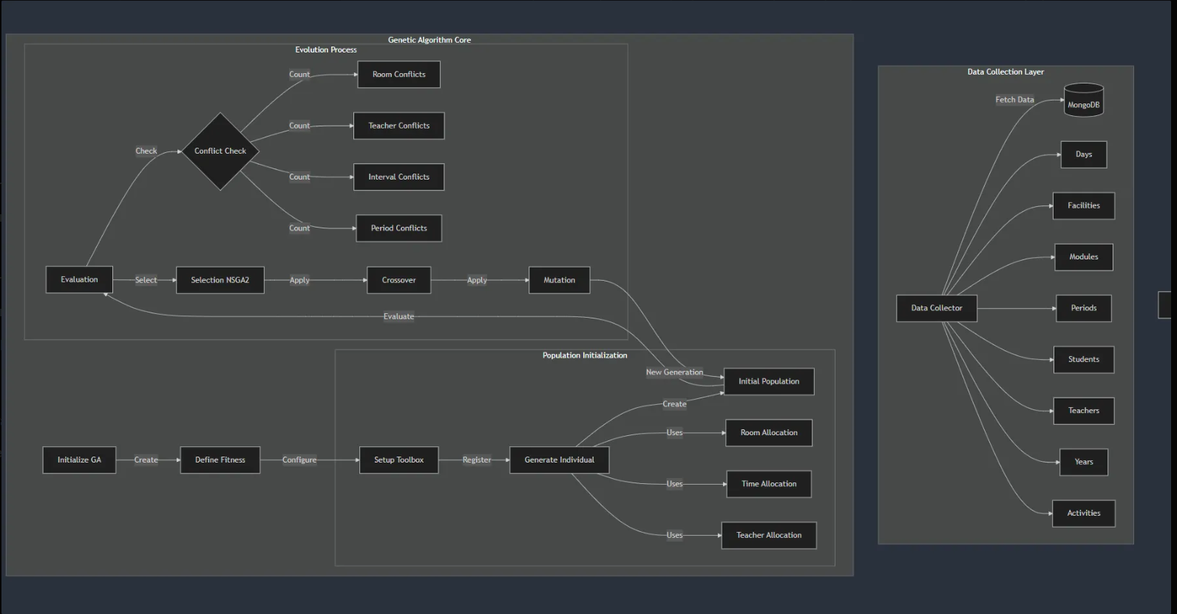
Flow of the Code

Slide 19
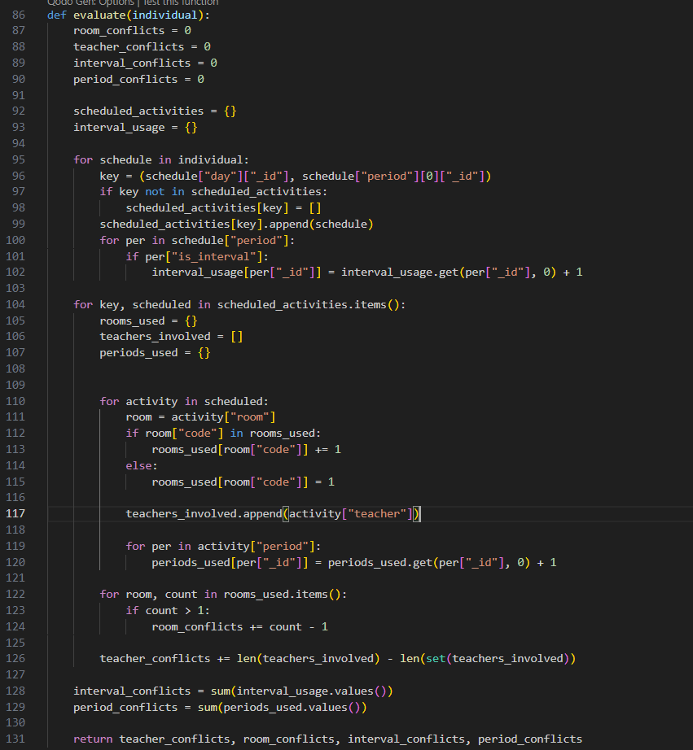
Evidences of Work Done
Evaluate Function for Genetic Algorithms

Slide 20
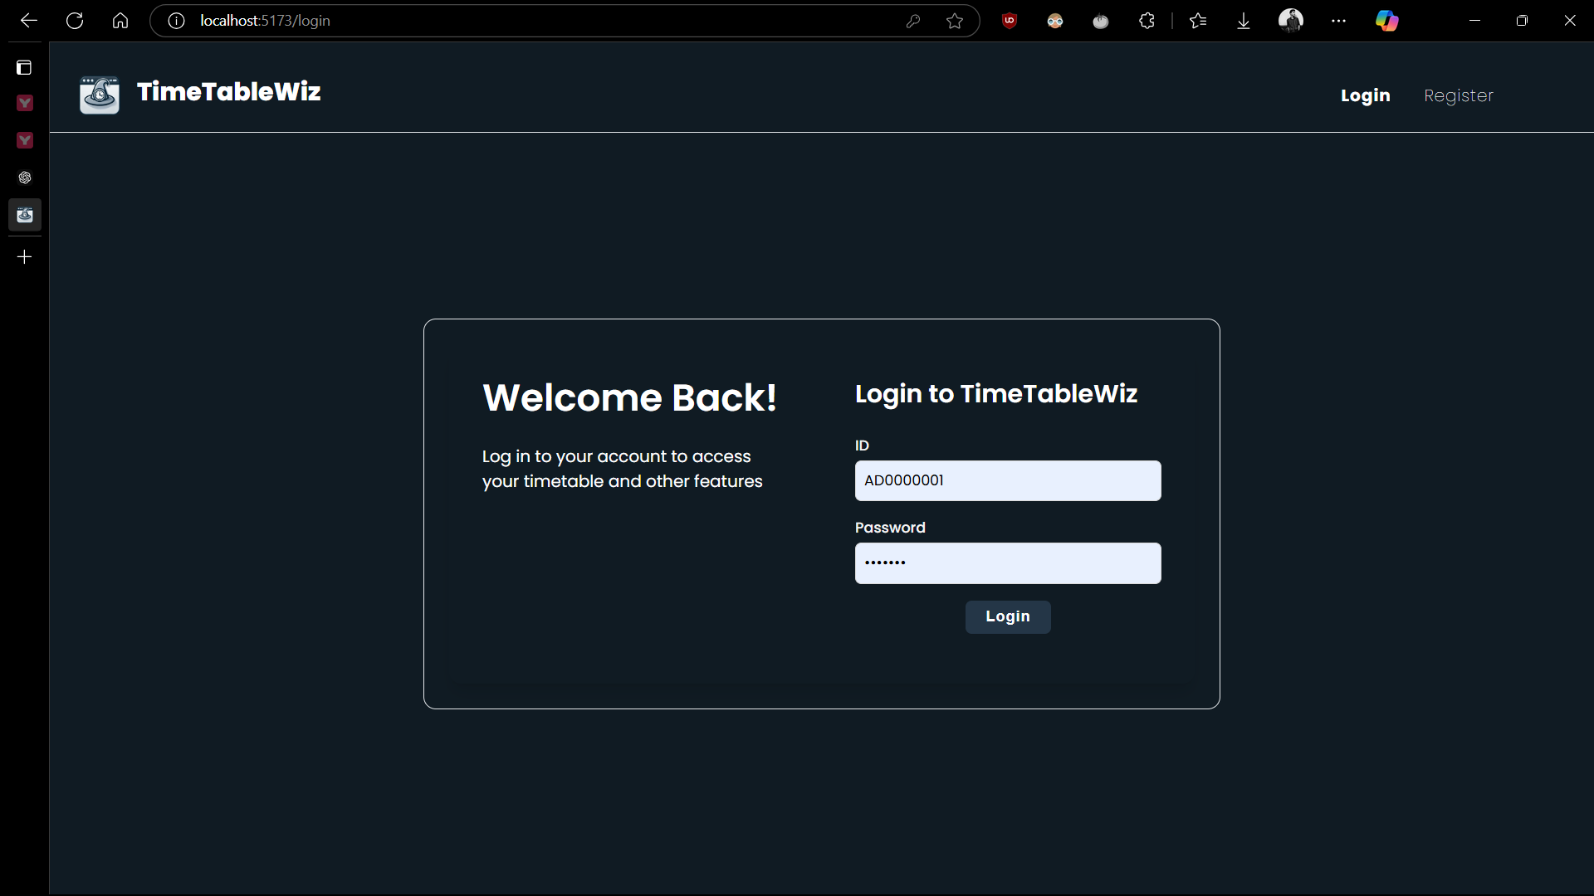
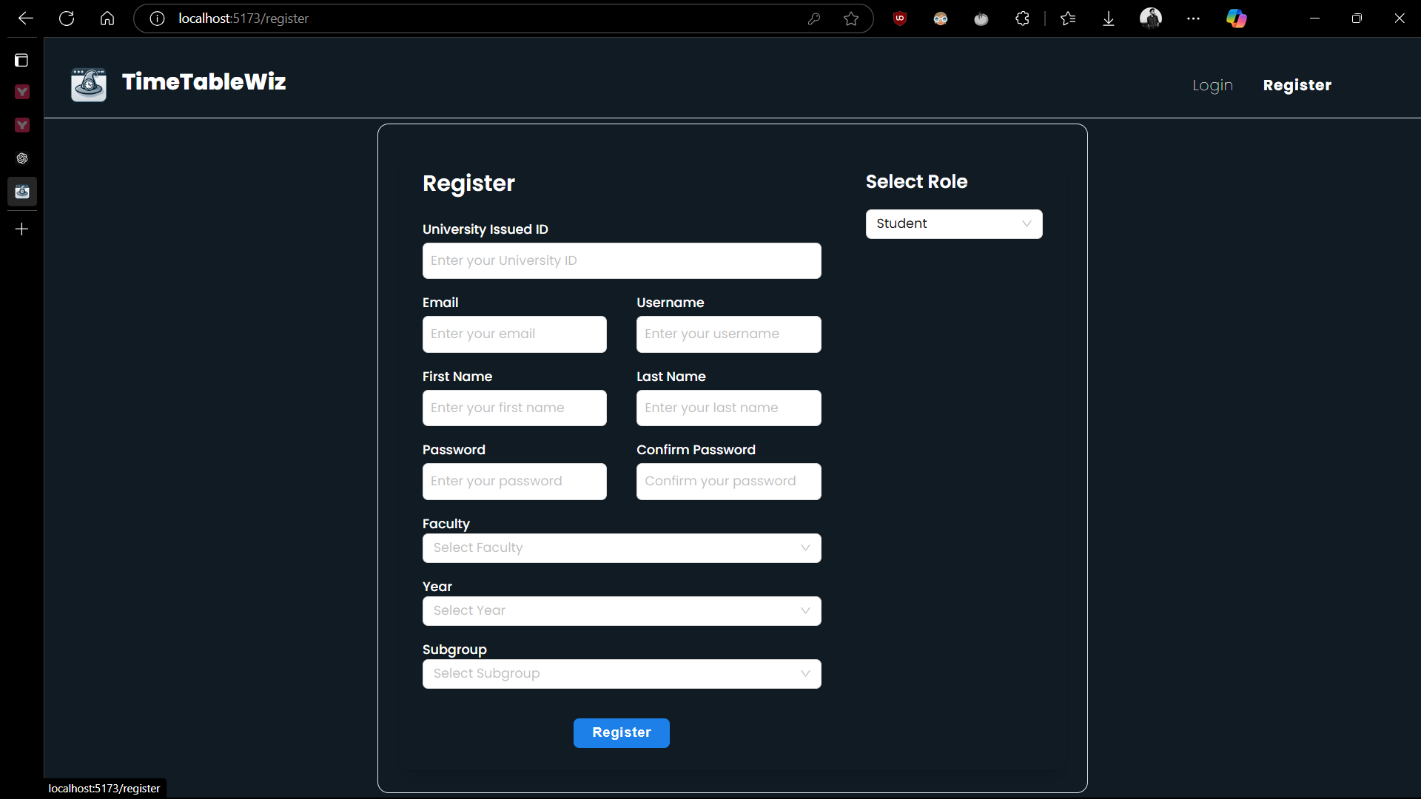
UI/UX

Slide 21
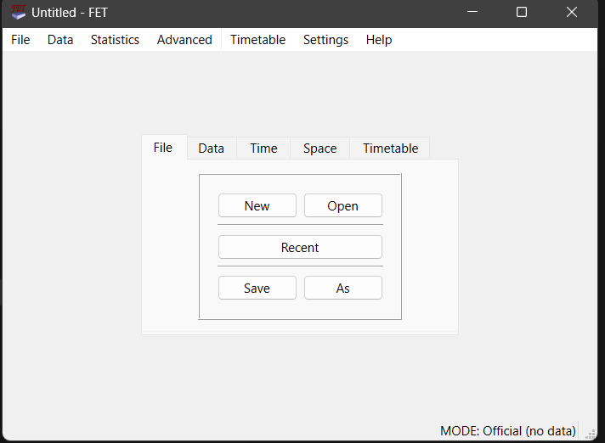
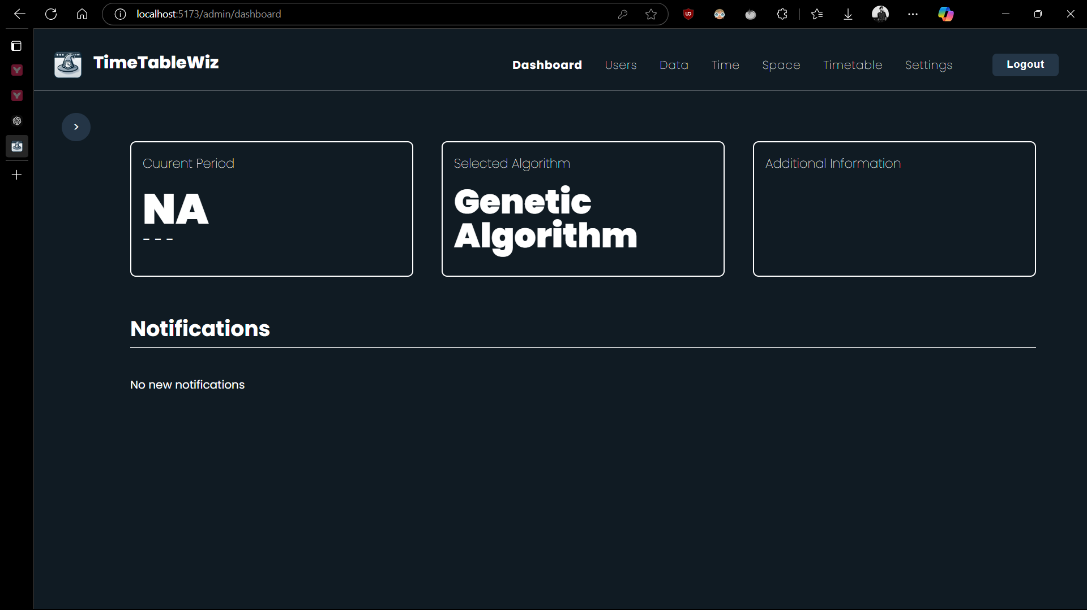
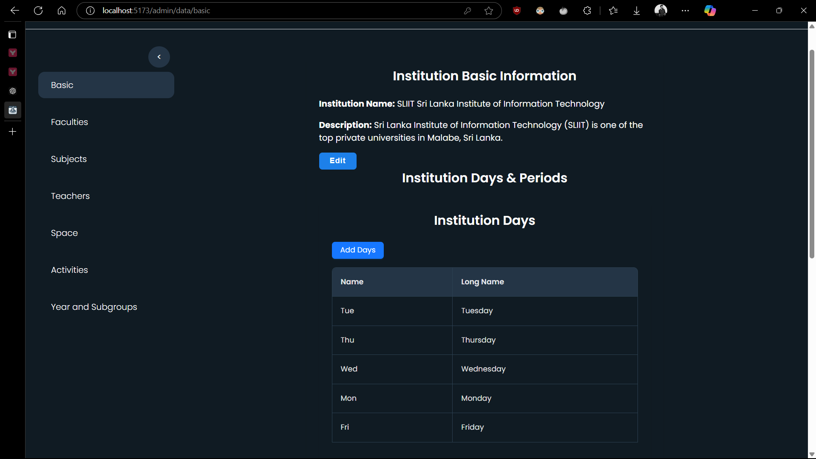
Comparison With Current Systems

Slide 22
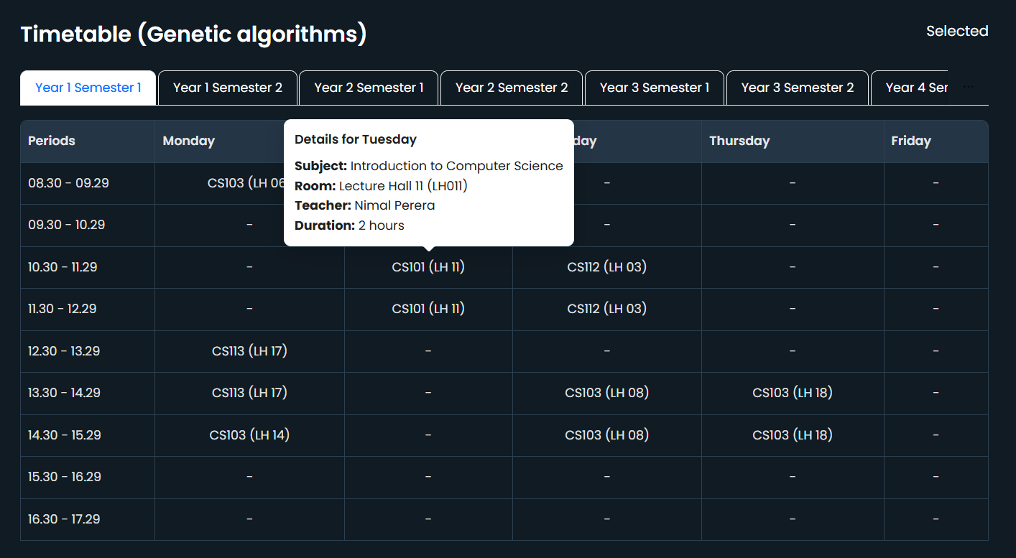
Timetable Generation

Slide 23

METHOLOGY
Component Diagram
Component Specific Requirements
Work Break Down Structure
IT21259852 | Weerasinghe K.D.E.I | 24-25J-238

Slide 24
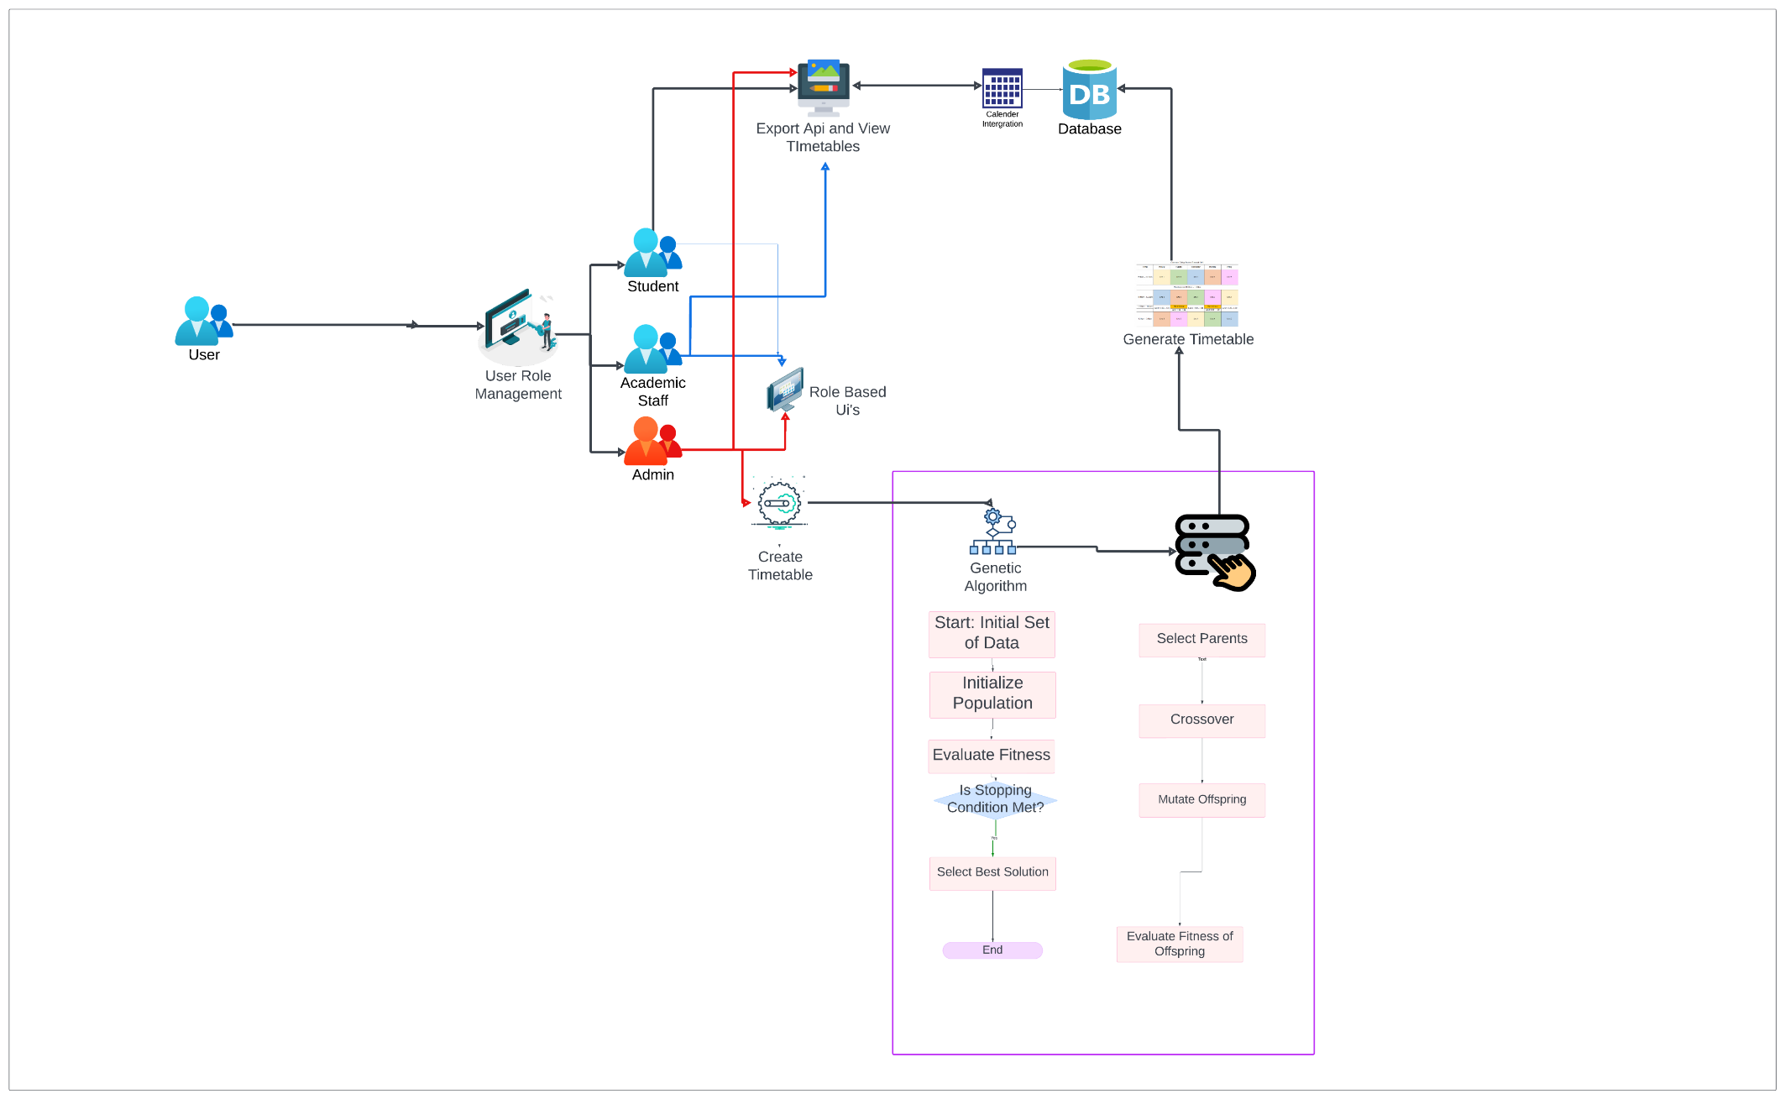
COMPONENT DIAGRAM
Colony Optimization for Timetable Scheduling & Manual Editing Feature
IT21259852 | Weerasinghe K.D.E.I | 24-25J-238

Slide 25
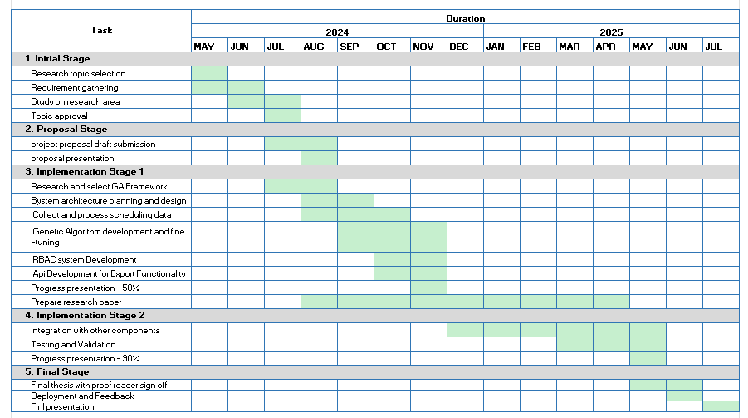
GANTT CHART
IT21172182 | Wijayawardhana G.L.C.N.D | IT21172182

Slide 26
References
[1] Herath, Achini Kumari, "Genetic Algorithm For University Course Timetabling Problem" (2017). Electronic Theses and Dissertations. 443
[2] Herath, Achini Kumari “Timetabling with Three-Parent Genetic Algorithm: a Preliminary Study (2018)”
[3] G. Alnowaini and A. A. Aljomai, "Genetic Algorithm For Solving University Course Timetabling Problem Using Dynamic Chromosomes," 2021 International Conference of Technology, Science and Administration (ICTSA), Taiz, Yemen, 2021, pp. 1-6, doi: 10.1109/ICTSA52017.2021.9406539.
[4] S. Abdullah, H. Turabieh, B. McCollum and P. McMullan, "A multi-objective post enrolment course timetabling problems: A new case study," IEEE Congress on Evolutionary Computation, Barcelona, Spain, 2010, pp. 1-7, doi: 10.1109/CEC.2010.5586227
[5] A. H. Khan and T. Imtiaz, "A Novel Genetic Algorithm Based Timetable Generator for Optimized University Timetable Solution," 2024 International Conference on Engineering & Computing Technologies (ICECT), Islamabad, Pakistan, 2024, pp. 1-6, doi: 10.1109/ICECT61618.2024.10581296.
IT21259852 | Weerasinghe K.D.E.I | 24-25J-238

Slide 27
2: Research and Development
Reinforcement Learning Algorithm for Timetable Generation
It21208980- De Silva K.H.P.N
BSc (Hons) Degree in Information Technology
(specialization in Information Technology)
IT21208980 | De Silva K. H. P. N | 24-25J-238

Slide 28
Introduction
Research Gap
Research Problem
Specific and Sub Objective
IT21208980 | De Silva K. H. P. N | 24-25J-238

Slide 29

INTRODUCTION
Reinforcement Learning (RL) is a type of mechine learning where agents learn to make decisions by interacting with their environment.
RL Agents are trained to optimize scheduling by exploring different actions and learning from rewards or penalties.
Q-Learning enables agents to learn the best scheduling strategies through trial and error.
Deep Q-Learning (DQL) extends Q-Learning using neural networks for handling more complex scheduling tasks.
Reward Mechanisms are designed to align with scheduling goals, such as minimizing conflicts and maximizing resource utilization.
RL Techniques offer flexibility and adaptability, making them effective for dynamic and complex timetable scheduling scenarios.
IT21208980 | De Silva K. H. P. N | 24-25J-238

Slide 30
RESERCH GAP
Research | Research Gap |  | User Defined Constraints | Real-Time Optimization
Deep-Reinforcement Learning based dynamic optimization of bus timetable[1] |  | No | Yes
A reinforcement learning approach for dynamic multi-objective optimization[4] |  | No | Yes
Multi-Agent Deep Reinforcement Learning for Large-Scale Traffic Signal Control[2] |  | No | Yes
A Review of Reinforcement Learning Based Intelligent Optimization for Manufacturing Scheduling [3] |  | No | Yes
Proposed System |  | Yes | Yes
IT21208980 | De Silva K. H. P. N | 24-25J-238

Slide 31

RESERCH QUESTION
“How can Reinforcement Learning algorithms be effectively implemented in university timetable scheduling systems to optimize scheduling decisions, minimize conflicts, and adapt to dynamically changing environments and constraints while maintaining efficiency and scalability?”
IT21208980 | De Silva K. H. P. N | 24-25J-238

Slide 32

MAIN AND SUB OBJECTIVE
Main Objectives
Research: Develop a specialized scheduling optimization system for educational environments using Reinforcement Learning (RL) methods.
System Development: Create an ETL process to handle and extract data from CSV, system, and Excel files
Sub Objectives
Develop and customize RL algorithms like Q-Learning, DQL, and SARSA to tackle complex scheduling challenges and adapt to changing conditions.
Ensure seamless integration with the RL scheduling system for efficient data management.
IT21208980 | De Silva K. H. P. N | 24-25J-238

Slide 33
METHOLOGY
Component Diagram
Key Technology
Project Requirement
Work Break Down Structure
IT21208980 | De Silva K. H. P. N | 24-25J-238

Slide 34
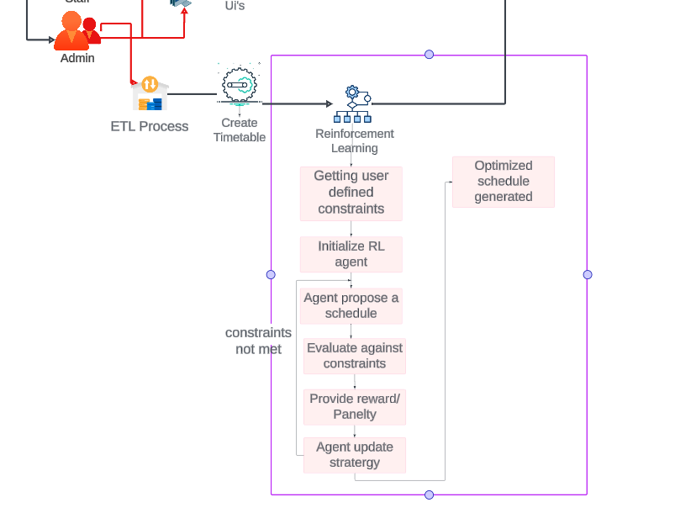
COMPONENT DIAGRAM
Reinforcement Learning for Timetable Scheduling & Manual Editing Feature
IT21208980 | De Silva K. H. P. N | 24-25J-238

Slide 35
Key Technology
Frontend Requirements
Programming Language - JavaScript
Libraries - React, ViteJS
Tools - NodeJS, Tailwind CSS
System Requirements
Operating System - Cross Platform
Software - Python, Node.js, PostgreSQL
Algorithm Requirements
Language - python
Libraries - NumPy, TensorFlow/PyTorch , OpenAI Gym, Matplotlib
Environment - Jupiter Notebook
Backend Requirements
Programming Language - Python, Flask
Database - PostgreSQL
IT21208980 | De Silva K. H. P. N | 24-25J-238

Slide 36

PROJECT REQUIREMENT
Functional Requirement | Non-Functional Requirement
Generate Schedules Using RL Algorithms Manual Adjustment of Schedules. Feedback and Learning Mechanism. Real-Time Conflict Detection. ETL System for Data Handling. | Performance Usability Reliability Scalability Security Maintainability Compatibility
IT21208980 | De Silva K. H. P. N | 24-25J-238

Slide 37
COMPLETION AND FUTURE WORK
Completion | Future Work
The basic Q-Learning algorithm in implemented to the system | Need to analyze two other algorithms Deep Q-learning and SARSA.
User Details Frontend part is completely integrated | Create an ETL process to handle and extract data from CSV, system, and Excel files
Merging the algorithm to the Intergrated system | Need to upgrade the UI Timetable generation and View.
IT21208980 | De Silva K.H.P.N | IT21208980

Slide 38
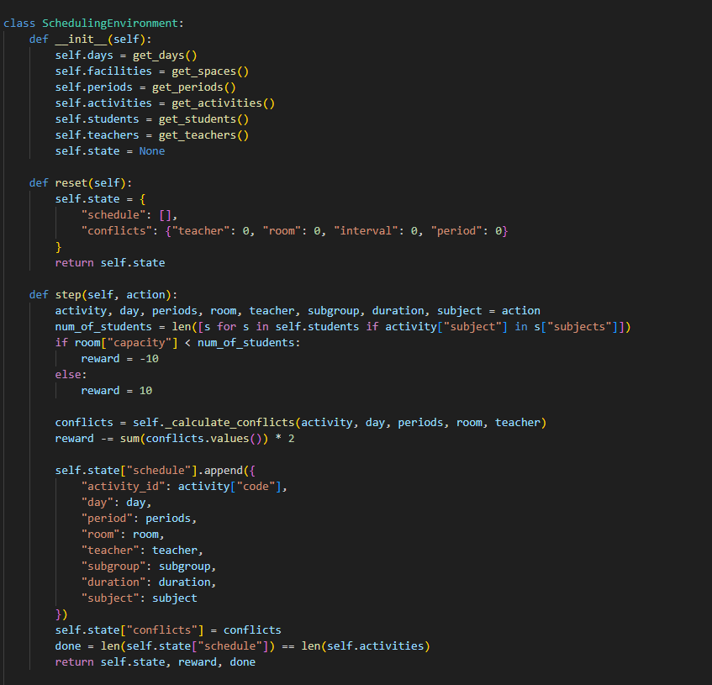
PROJECT EVIDENCE
The environment in which the Q-Learning agent operates
IT21208980 | De Silva K.H.P.N | IT21208980

Slide 39
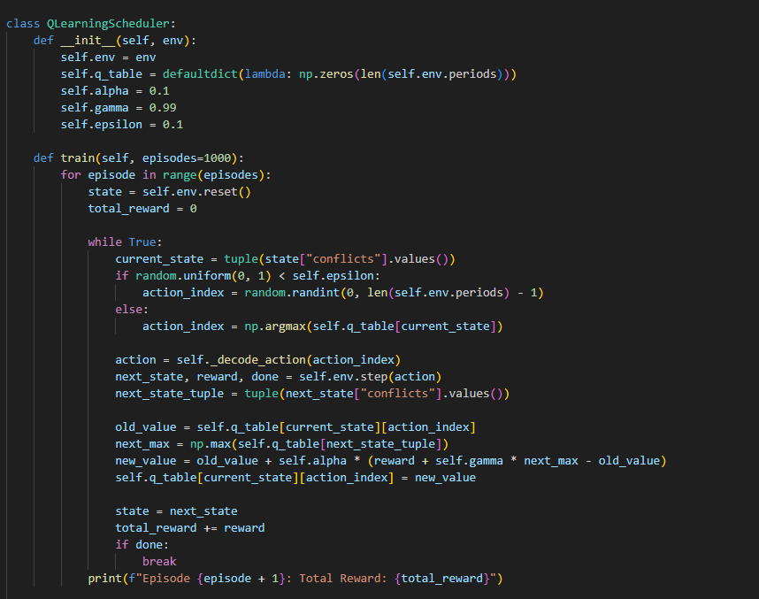
PROJECT EVIDENCE
The Q-Learning Scheduler used in the training
The Q-table is updated using the Bellman equation
IT21208980 | De Silva K.H.P.N | IT21208980

Slide 40
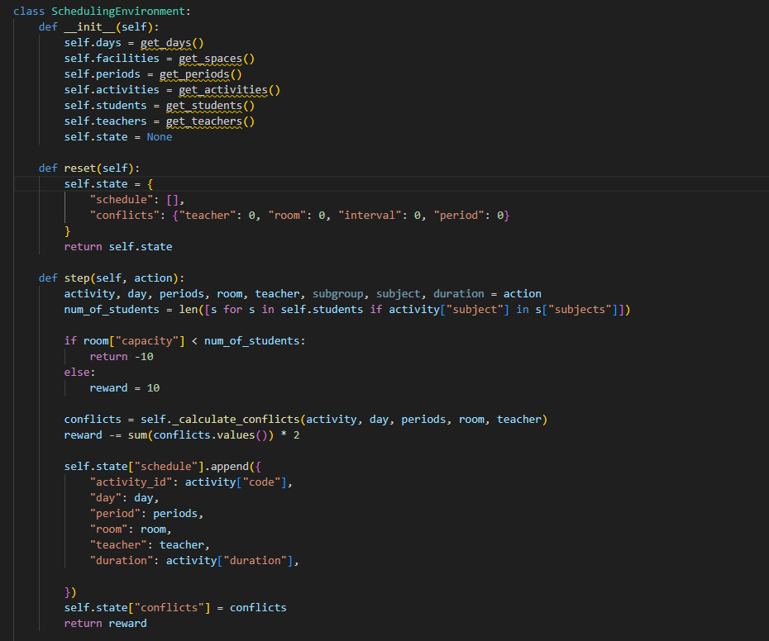
PROJECT EVIDENCE
Calculating the rewards based on the values in the activities
New_reward = reward - conflict
IT21208980 | De Silva K.H.P.N | IT21208980

Slide 41
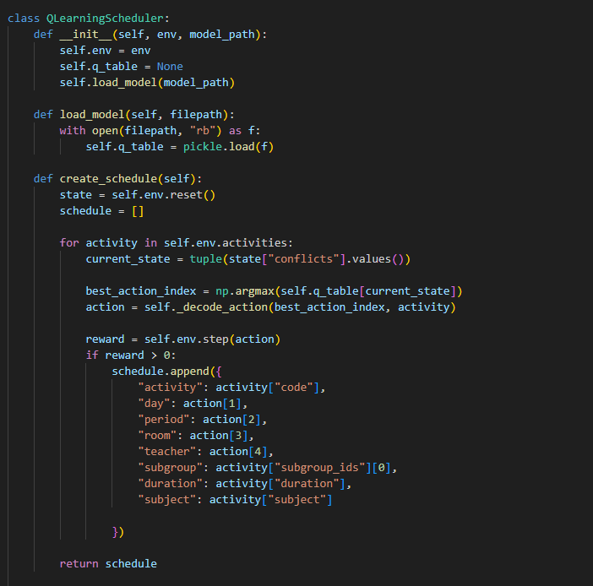
PROJECT EVIDENCE
Generating the timetable by appending activities by using the previously trained Q-table.
IT21208980 | De Silva K.H.P.N | IT21208980

Slide 42
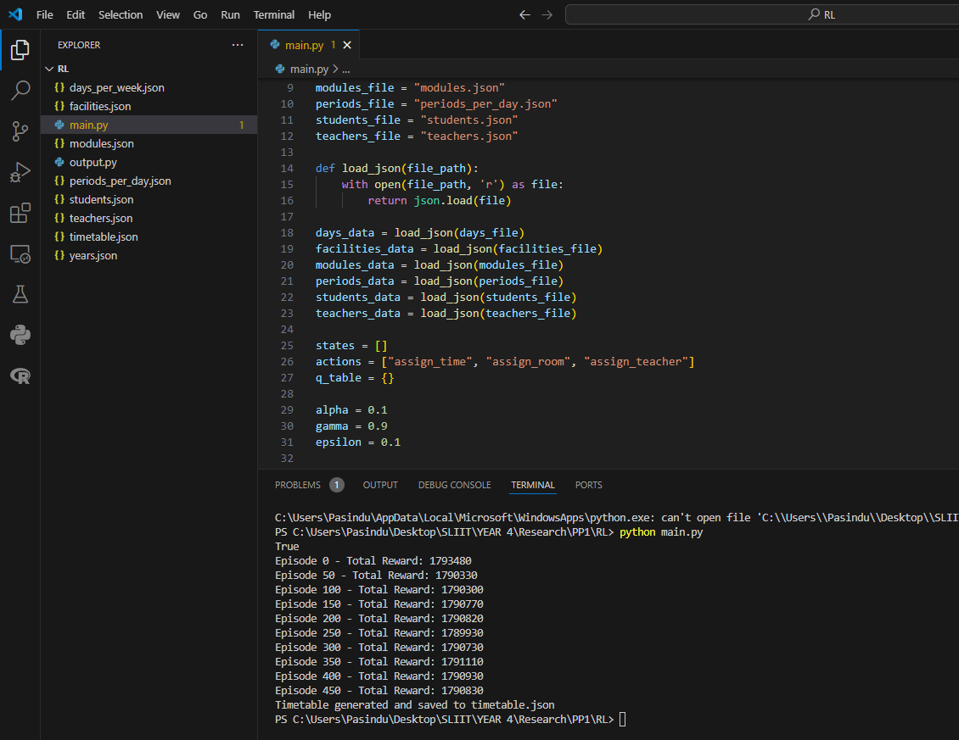
PROJECT EVIDENCE
The reward results for 500 epochs
IT21208980 | De Silva K.H.P.N | IT21208980

Slide 43
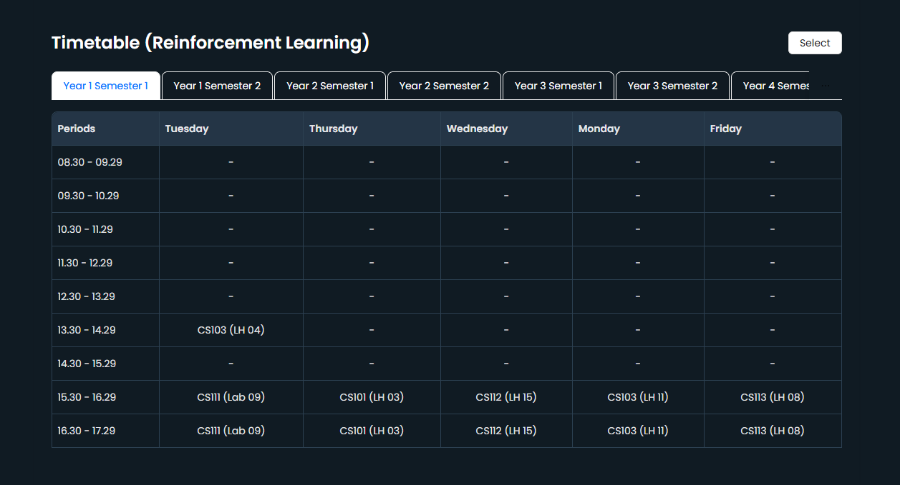
PROJECT EVIDENCE
The Optimized Timetable shown in the UI generated using RL algorithm
IT21208980 | De Silva K.H.P.N | IT21208980

Slide 44
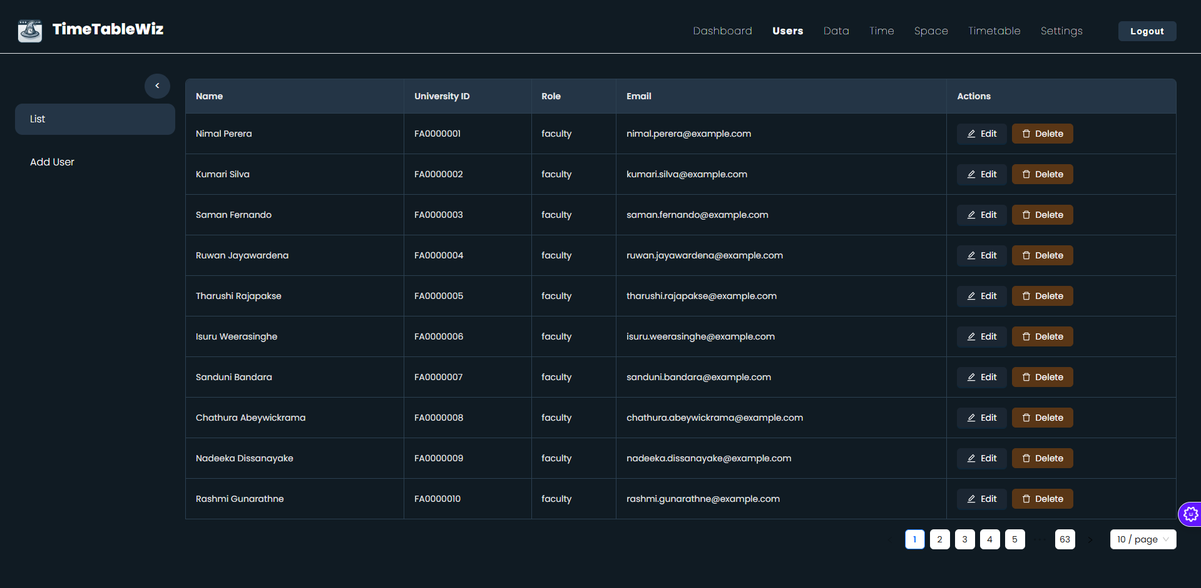
PROJECT EVIDENCE
Front-end User details interface
IT21208980 | De Silva K.H.P.N | IT21208980

Slide 45
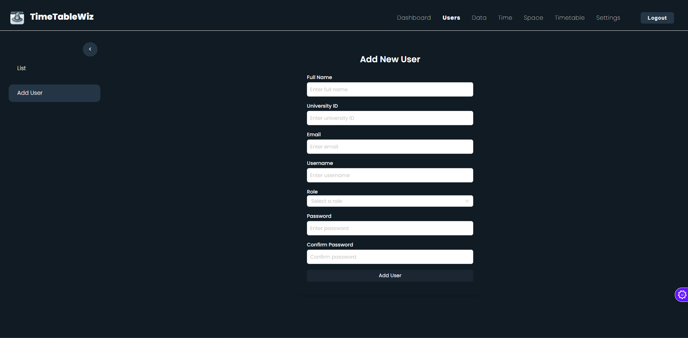
PROJECT EVIDENCE
Front-end Add-User details interface
IT21208980 | De Silva K.H.P.N | IT21208980

Slide 46
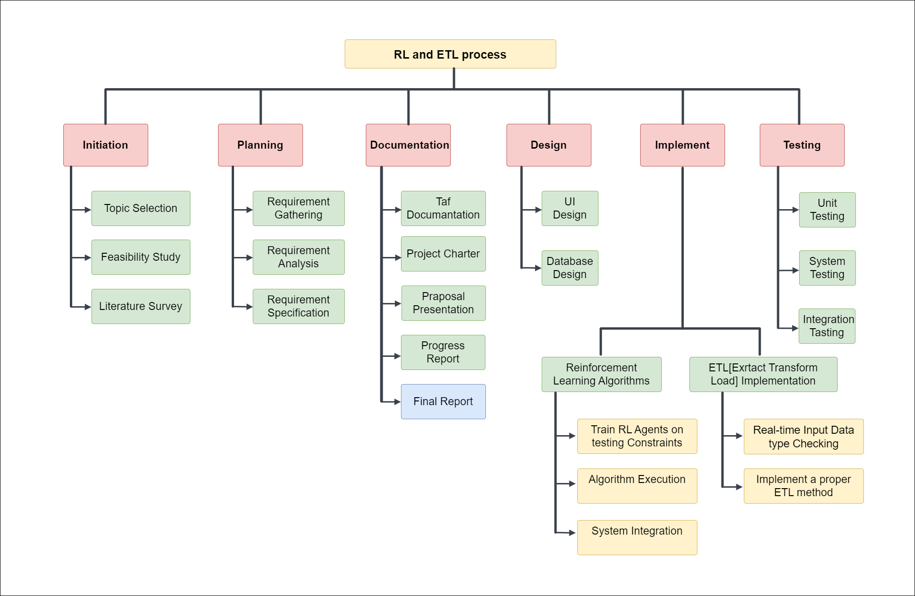
WORK BREAK DOWN STRUCTURE
IT21208980 | De Silva K. H. P. N | 24-25J-238

Slide 47
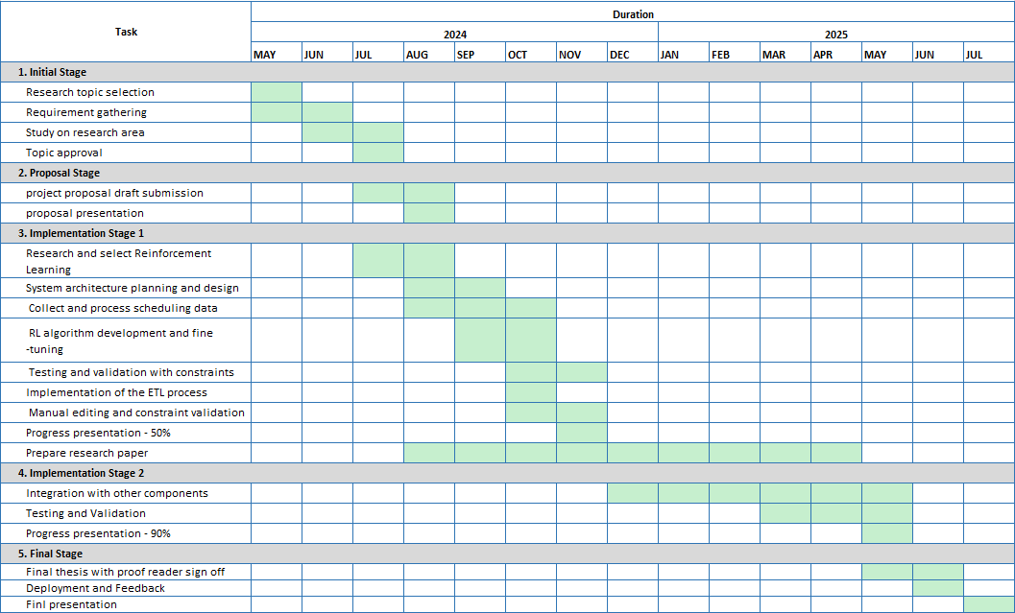
GANTT CHART
IT21208980 | De Silva K. H. P. N | 24-25J-238

Slide 48
REFERENCES
[1] X. Z. C. W. Guanqun Ai, "Deep Reinforcement Learning based dynamic optimization of bus timetable," [Online]. Available: https://www.sciencedirect.com/science/article/abs/pii/S1568494622008018.
[2]"MADRL(Multi-AgentDeepReinforcementLearning),"[Online].Available: https://drive.google.com/drive/folders/1UdSZBGoyEDig_76Xb2tQI6z-x3Mfx2yL?usp=sharing.
[3] "A Review of Reinforcement Learning Based Intelligent Optimization for Manufacturing Scheduling," [Online]. Available: https://ieeexplore.ieee.org/abstract/document/9673698.
[4] "A reinforcement learning approach for dynamic multi-objective optimization," [Online]. Available: https://www.sciencedirect.com/science/article/abs/pii/S0020025520308677.
[5] S. Yeo, S. Lee, B. Choi and S. Oh, "Integrate multi-agent simulation environment and multi-agent reinforcement learning (MARL) for real-world scenario," 2020 International Conference on Information and Communication Technology Convergence (ICTC), Jeju, Korea (South), 2020, pp. 523-525, doi: 10.1109/ICTC49870.2020.9289369.
IT21208980 | De Silva K. H. P. N | 24-25J-238

Slide 49

3: Research and Develop Colony Algorithm for Time Table Generation
IT21172182 | Wijayawardhana G.L.C.N.D
BSc (Hons) Degree in Information Technology (specialization in Information Technology)
IT21172182 | Wijayawardhana G.L.C.N.D | | 24-25J-238

Slide 50
INTRODUCTION
Colony optimization algorithms follow ant and bee, swarm behaviors, using collective intelligence to solve complex problems.
ACO imitates ant foraging, using pheromones to find the shortest path in scheduling.
BCO follow honey bees to find the best scheduling solutions.
Particle swarm algorithms use swarm intelligence, where basic agents collaborate to solve scheduling problems.
Colony optimization techniques are highly effective in timetable scheduling, efficiently handling multiple constraints like room capacity, faculty availability, and course requirements.
IT21172182 | Wijayawardhana G.L.C.N.D | IT21172182

Slide 51
RESEARCH QUESTION
“How can colony optimization algorithms be efficiently created and applied in university the timetable scheduling systems to achieve best resource allocation and conflict resolution while remaining scalable and adaptable to changing constraints?”
IT21172182 | Wijayawardhana G.L.C.N.D | IT21172182

Slide 52
MAIN AND SUB OBJECTIVE
Main Objective
Develop a dynamic feedback system that continuously checks the performance of the generated schedules and adjusts the CO algorithms in real time depending on emerging barriers, conflicts, and user inputs.
Ensure Conflict-Free Manual Editing with Constraint Matching
Sub Objective
ACO, BCO, and PSO algorithms to handle timetable-specific constraints like class conflicts and resource allocation.
IT21172182 | Wijayawardhana G.L.C.N.D | IT21172182

Slide 53
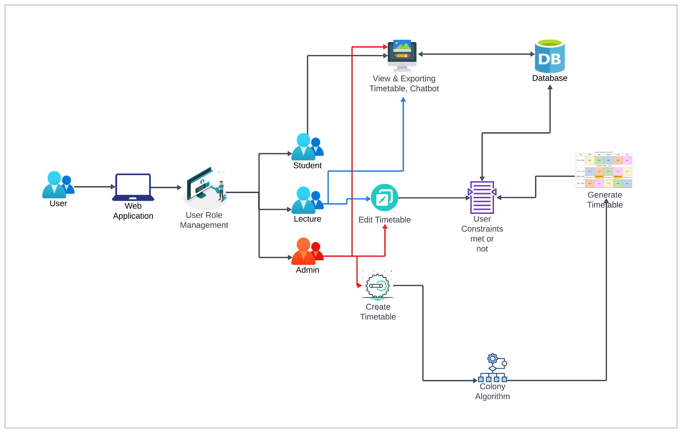
COMPONENT DIAGRAM
Colony Optimization for Timetable Scheduling & Manual Editing Feature
IT21172182 | Wijayawardhana G.L.C.N.D | IT21172182

Slide 54
Key Technology
Frontend Requirements
Programming Language - JavaScript
Libraries - React, ViteJS
Tools - NodeJS, Tailwind CSS
System Requirements
Operating System - Cross Platform
Software - Python, Node.js, PostgreSQL
Algorithm Requirements
Language - python
Libraries - NumPy, SciPy, ACO, Matplotlib
Environment - Jupiter Notebook
Backend Requirements
Programming Language - Python, Flask
Database - PostgreSQL
IT21172182 | Wijayawardhana G.L.C.N.D | IT21172182

Slide 55
PROJECT REQUIREMENT
Functional Requirement | Non-Functional Requirement
generate schedules using colony optimization techniques to ensure optimal allocation of time slots, spaces and resources Users must be able to manually edit the generated schedule through a user-friendly interface, with real-time conflict detection and resolution The system must detect conflicts The system must store schedules, pheromone levels, etc. user changes in a database to ensure data consistency and version control. | Performance Usability Reliability Scalability Security Maintainability Compatibility
IT21172182 | Wijayawardhana G.L.C.N.D | IT21172182

Slide 56
COMPLETION AND FUTURE WORK
Completion | Future Work
The basic Ant Colony algorithm in implemented to the system | Need to analyze two other algorithms BCO & PSO
Faculty Data Details Frontend part is completely integrated | manual editing features with conflict detection
Merging the algorithm to the Intergrated system | Need to upgrade the UI Timetable generation and View.
IT21172182 | Wijayawardhana G.L.C.N.D | IT21172182

Slide 57
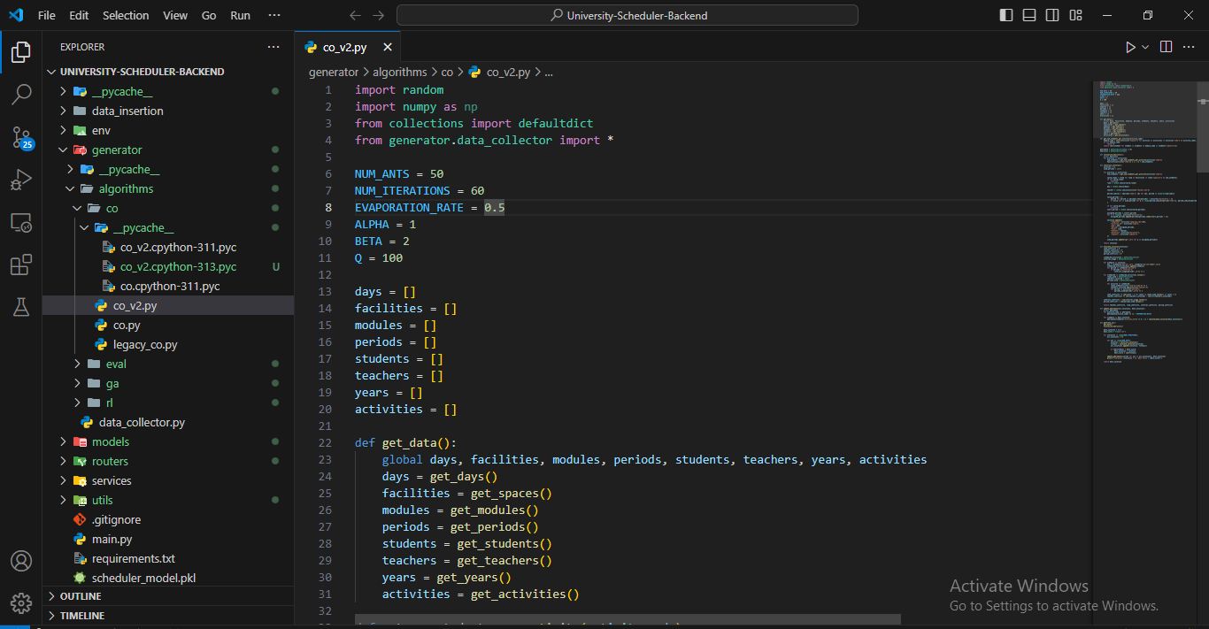
PROJECT EVIDENCE
The Backend Part of the ACO Algorithm

Slide 58
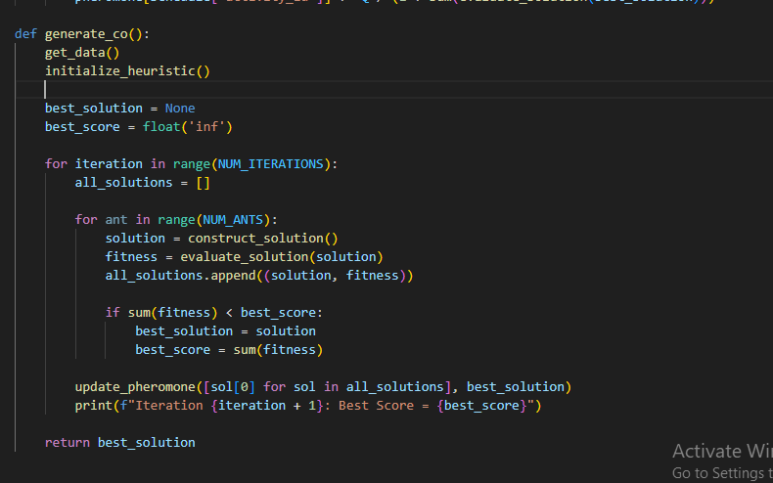
PROJECT EVIDENCE
Ant Colony Optimization: Solution Generation and Iterative Improvement

Slide 59
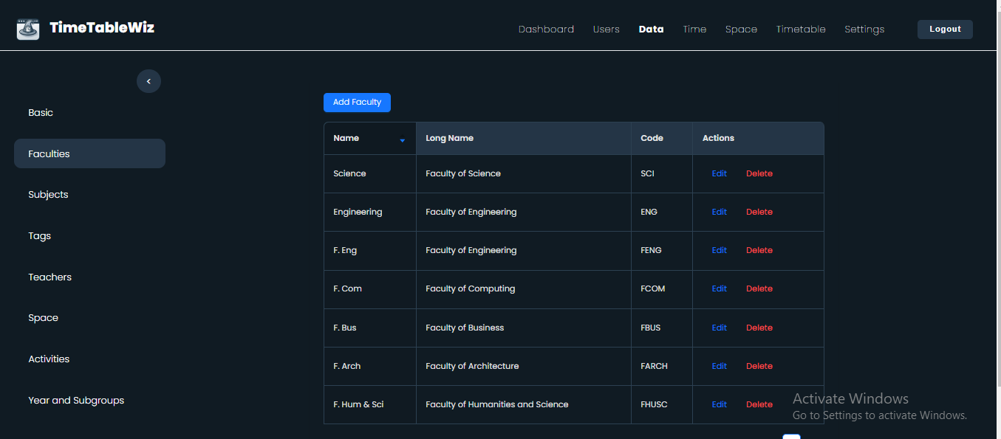
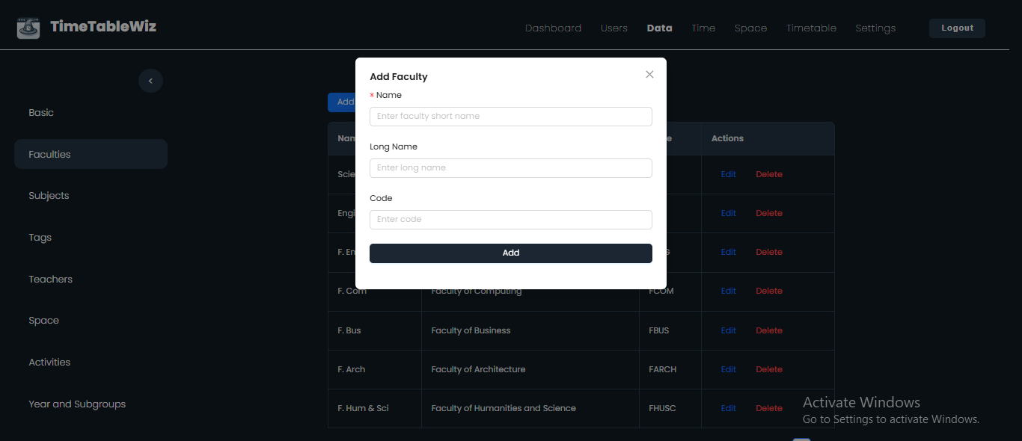
PROJECT EVIDENCE
Manage Faculty Details
Add New Faculty

Slide 60
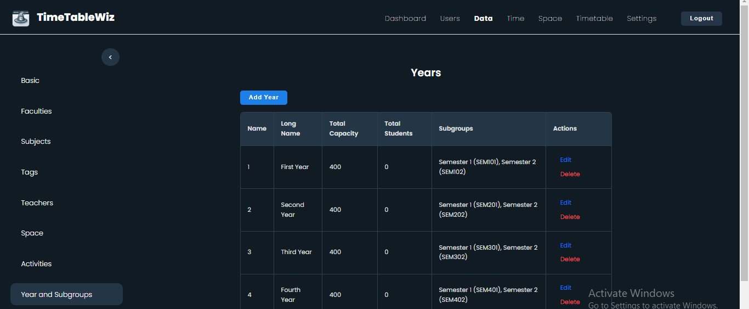
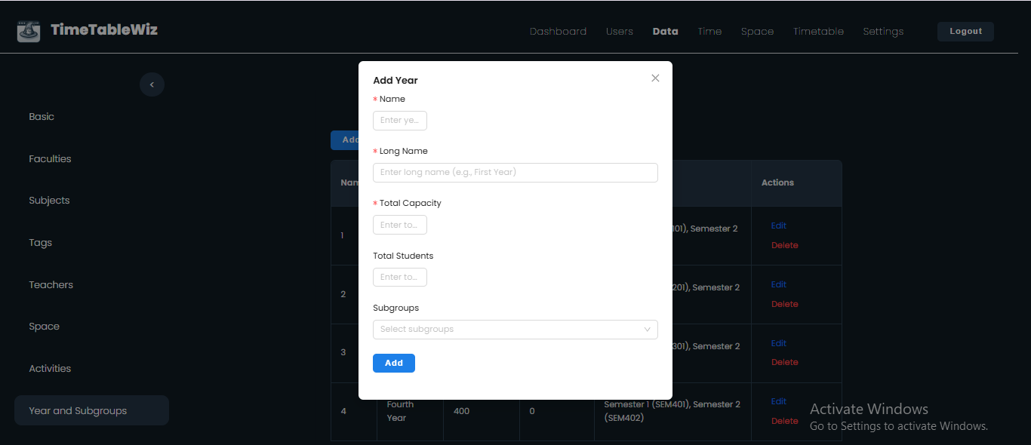
PROJECT EVIDENCE
Manage Year Details
Add Year and Sub Group

Slide 61
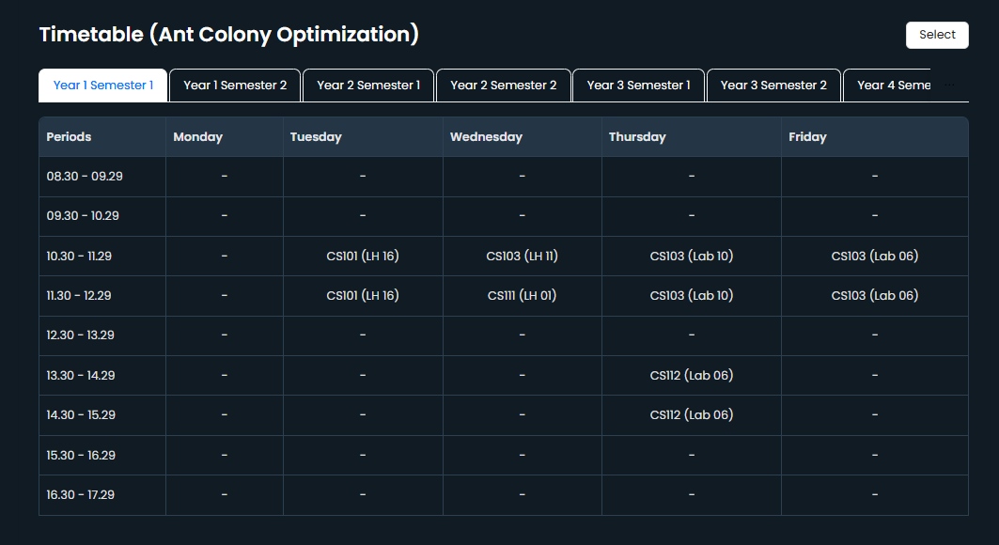
PROJECT EVIDENCE
The Optimized Timetable shown in the UI generated using ACO algorithm
IT21172182 | Wijayawardhana G.L.C.N.D | IT21172182

Slide 62
REFERENCES
[1] L. Zuo, L. Shu, S. Dong, C. Zhu, and T. Hara, "A Multi-Objective Optimization Scheduling Method Based on the Ant Colony Algorithm in Cloud Computing," IEEE Access, vol. 7, pp. 1-9, 2019.
[2] B. Kumar and D. Kumar, "A review on Artificial Bee Colony algorithm," International Journal of Engineering and Technology, vol. 7, no. 4, pp. 1-5, 2018.
[3] V. Sahargahi and M. R. F. Derakhshi, "Research Paper: Comparing the Methods of Creating Educational Timetable," Journal of Computer and Information Science, vol. 9, no. 4, pp. 1-6, 2016.
[4] P. Pongchairerks, "Particle swarm optimization algorithm applied to scheduling problems," International Journal of Industrial Engineering, vol. 27, no. 3, pp. 1-7, 2017.
[5] D. Ojha, R. Kumar Sahoo, and S. Das, "Automated Timetable Generation using Bee Colony Optimization," International Journal of Applied Information Systems (IJAIS), vol. 12, no. 5, pp. 1-8, 2019.
[6] M. Mazlan, M. Makhtar, A. F. K. A. Khairi, and M. A. Mohamed, "University course timetabling model using ant colony optimization algorithm approach," IEEE Access, vol. 8, pp. 1-9, 2019.
IT21172182 | Wijayawardhana G.L.C.N.D | IT21172182

Slide 63
IT21266164 Udayantha d.m.s
BSc (Hons) Degree in Information Technology (specialization in Information Technology)
Research ,Developing an effective timetable evaluation method
IT21266164 | Udayantha D.M.S | 24-25J-238

Slide 64
INTRODUCTION
Develop a robust system to evaluate university timetables generated by advanced algorithms.
Assessing timetables generated by various algorithms (GA, RL, CO)
Scoring Mechanism
Components:
Hard and soft constraint evaluation
Resource utilization metrics
Organizational goal alignment
Chatbot Integration:
Allows lecturers and students to check lecture times, locations, and other relevant details through a chatbot interface.
IT21266164 | Udayantha D.M.S | 24-25J-238

Slide 65
RESEARCH QUESTION
“How can a comprehensive timetable evaluation system, incorporating advanced algorithms, effectively assess and optimize university timetables to meet specific constraints, enhance resource utilization, and align with organizational goals?”
IT21266164 | Udayantha D.M.S | 24-25J-238

Slide 66
Main AND SUB OBJECTIVE
Main Objective
Develop a comprehensive timetable evaluation system that rigorously assesses university schedules generated by advanced algorithms, ensuring they meet specified constraints, optimize resource utilization, and align with organizational goals.
Sub Objective
Evaluate Constraint Compliance
Develop a Scoring Mechanism:
Create a comprehensive scoring system that integrates constraint adherence, resource optimization, workload balance, and other critical factors.
Compare Algorithm Performance:
Analyze the effectiveness of different algorithms in generating optimal timetables.
IT21266164 | Udayantha D.M.S | 24-25J-238

Slide 67
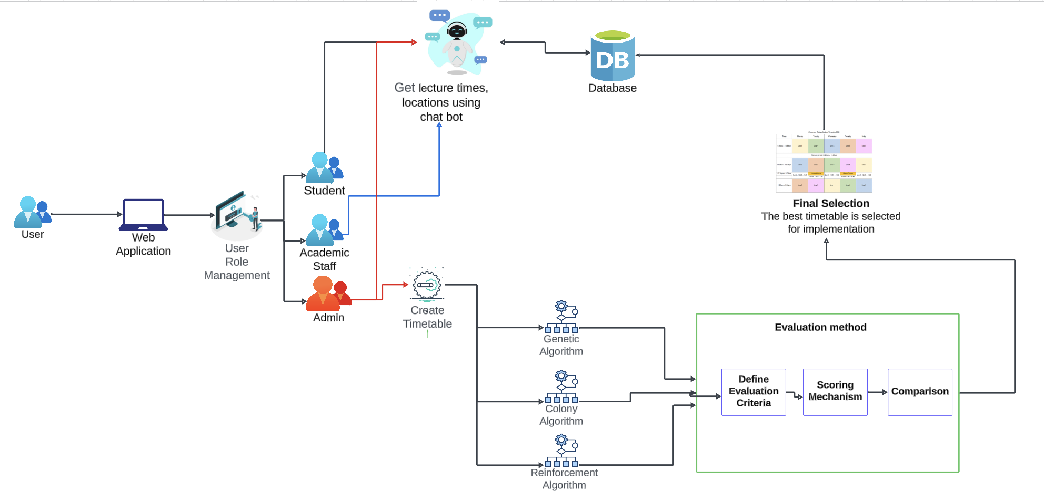
COMPONENT DIAGRAM
Timetable Evaluation method and chatbot
IT21266164 | Udayantha D.M.S | 24-25J-238

Slide 68
Key Technology
Frontend Requirements
Programming Language - JavaScript
Libraries - React, ViteJS
Tools - NodeJS, Tailwind CSS
System Requirements
Operating System - Cross Platform
Software - Python, Node.js, PostgreSQL
Algorithm Requirements
Language - python
Libraries - NumPy, SciPy, ACO, Matplotlib
Environment - Jupiter Notebook
Backend Requirements
Programming Language - Python, Flask
Database - PostgreSQL
IT21266164 | Udayantha D.M.S | 24-25J-238

Slide 69
PROJECT REQUIREMENT
Functional Requirement | Non-Functional Requirement
The system must accept timetables generated by various scheduling algorithms and allow the input of relevant constraints, room information, instructor availability, and course priorities. The system must identify and penalize violations of hard constraints like scheduling conflicts and room overcapacity, and assess soft constraint violations appropriately. The system must calculate a comprehensive score for each timetable, accounting for constraint violations, objective achievements, resource use, workload balance, compactness, and priority handling. The system must clearly rank timetables based on quality and criteria adherence, enabling easy comparison and selection. | Performance Usability Reliability Scalability Security Maintainability Compatibility
IT21266164 | Udayantha D.M.S | 24-25J-238

Slide 70
COMPLETION AND FUTURE WORK
Completion | Future Work
Robust Scoring Mechanism implemented to the system | Enhanced Chatbot Integration
Activity,Teacher and subjects Data Details Frontend part is completely integrated | Incorporate real-time schedule adjustments to account for last-minute changes like instructor unavailability or room changes.
Merging the algorithm to the Intergrated system
Algorithm Performance Comparison Facilitates detailed comparison of timetables generated by Genetic Algorithms, Reinforcement Learning, and Colony Optimization.
IT21266164 | Udayantha D.M.S | 24-25J-238

Slide 71
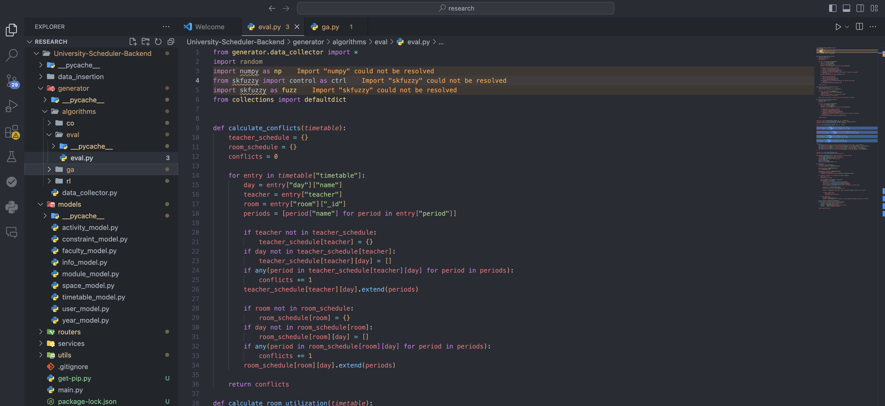
PROJECT EVIDENCE
The Backend Part of the evaluation algorithm
IT21266164 | udayantha D,M S | IT21266164

Slide 72
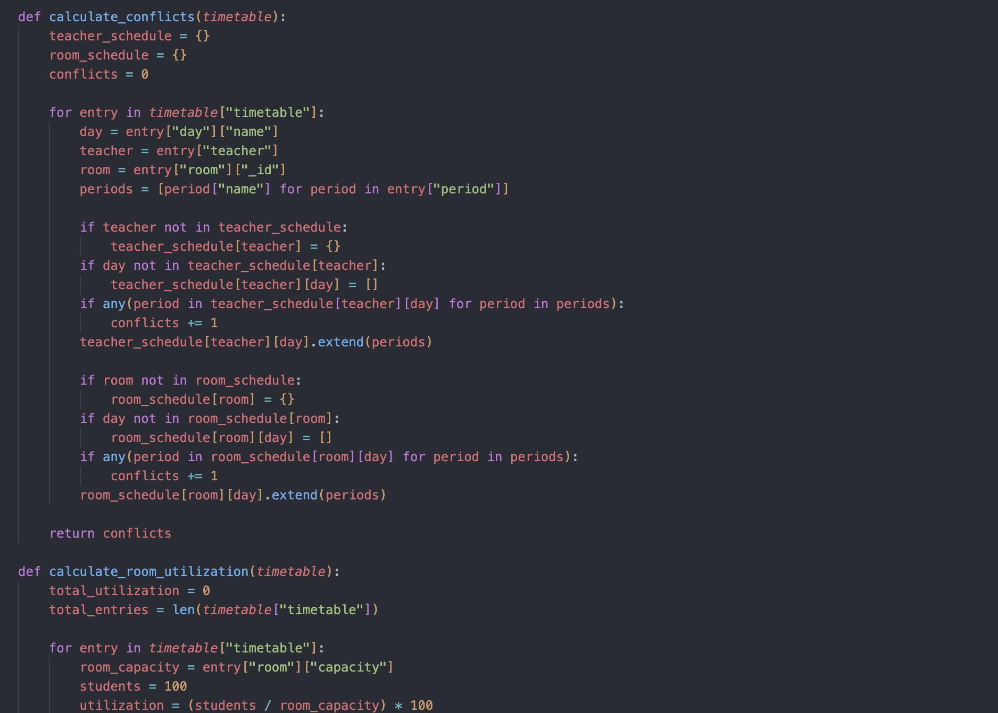
PROJECT EVIDENCE
Conflict Calculation Functions
IT21266164 | Udayantha D.M.S | 24-25J-238

Slide 73
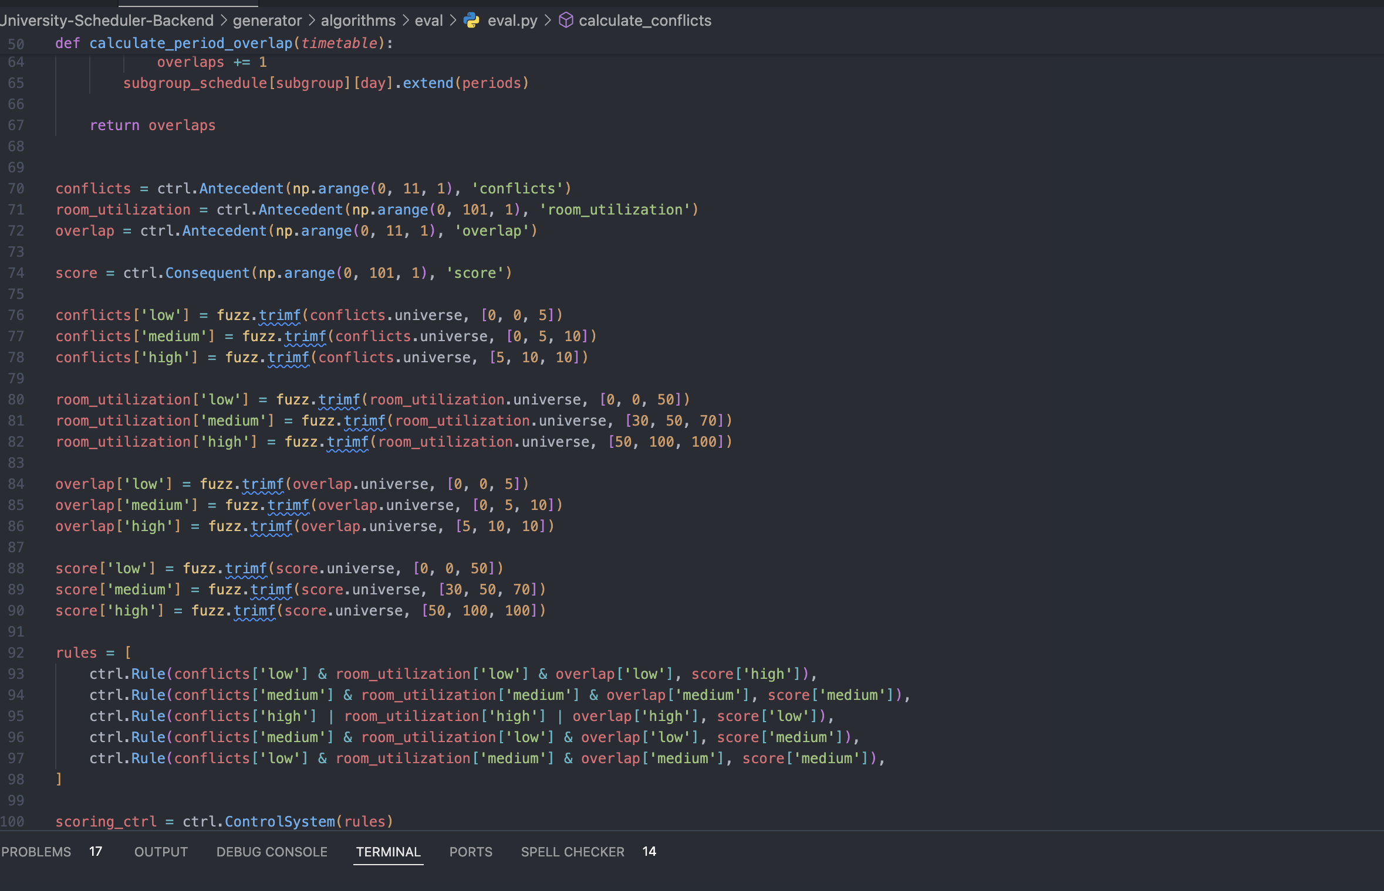
Use Fuzzy Membership Function

Slide 74
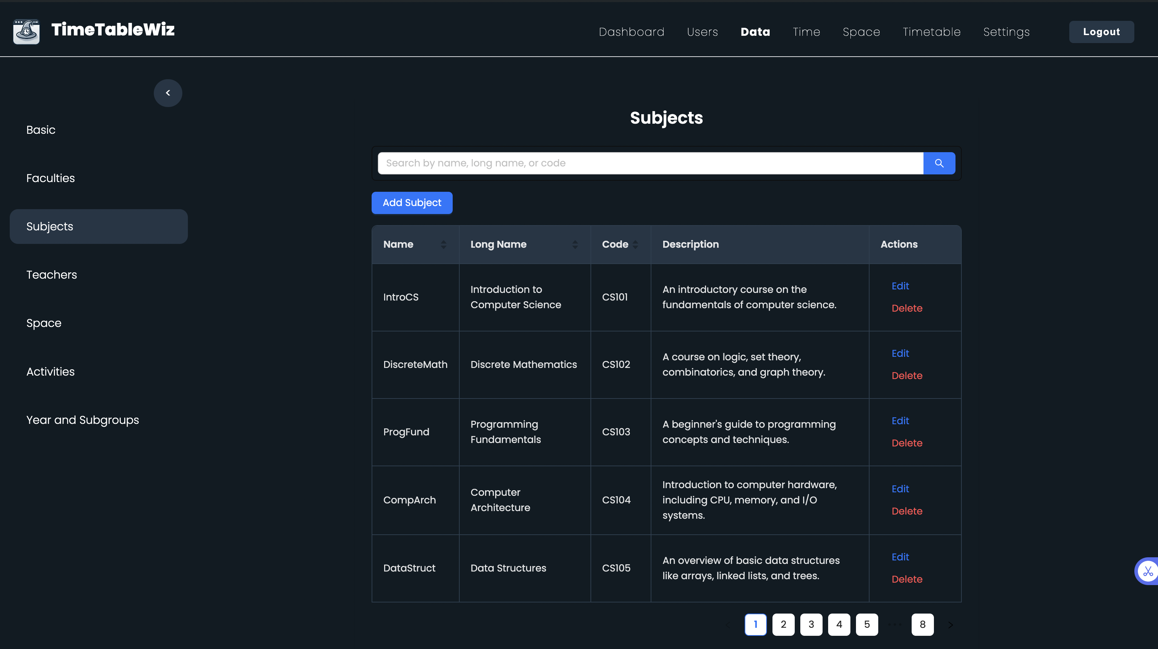
PROJECT EVIDENCE
subject management

Slide 75
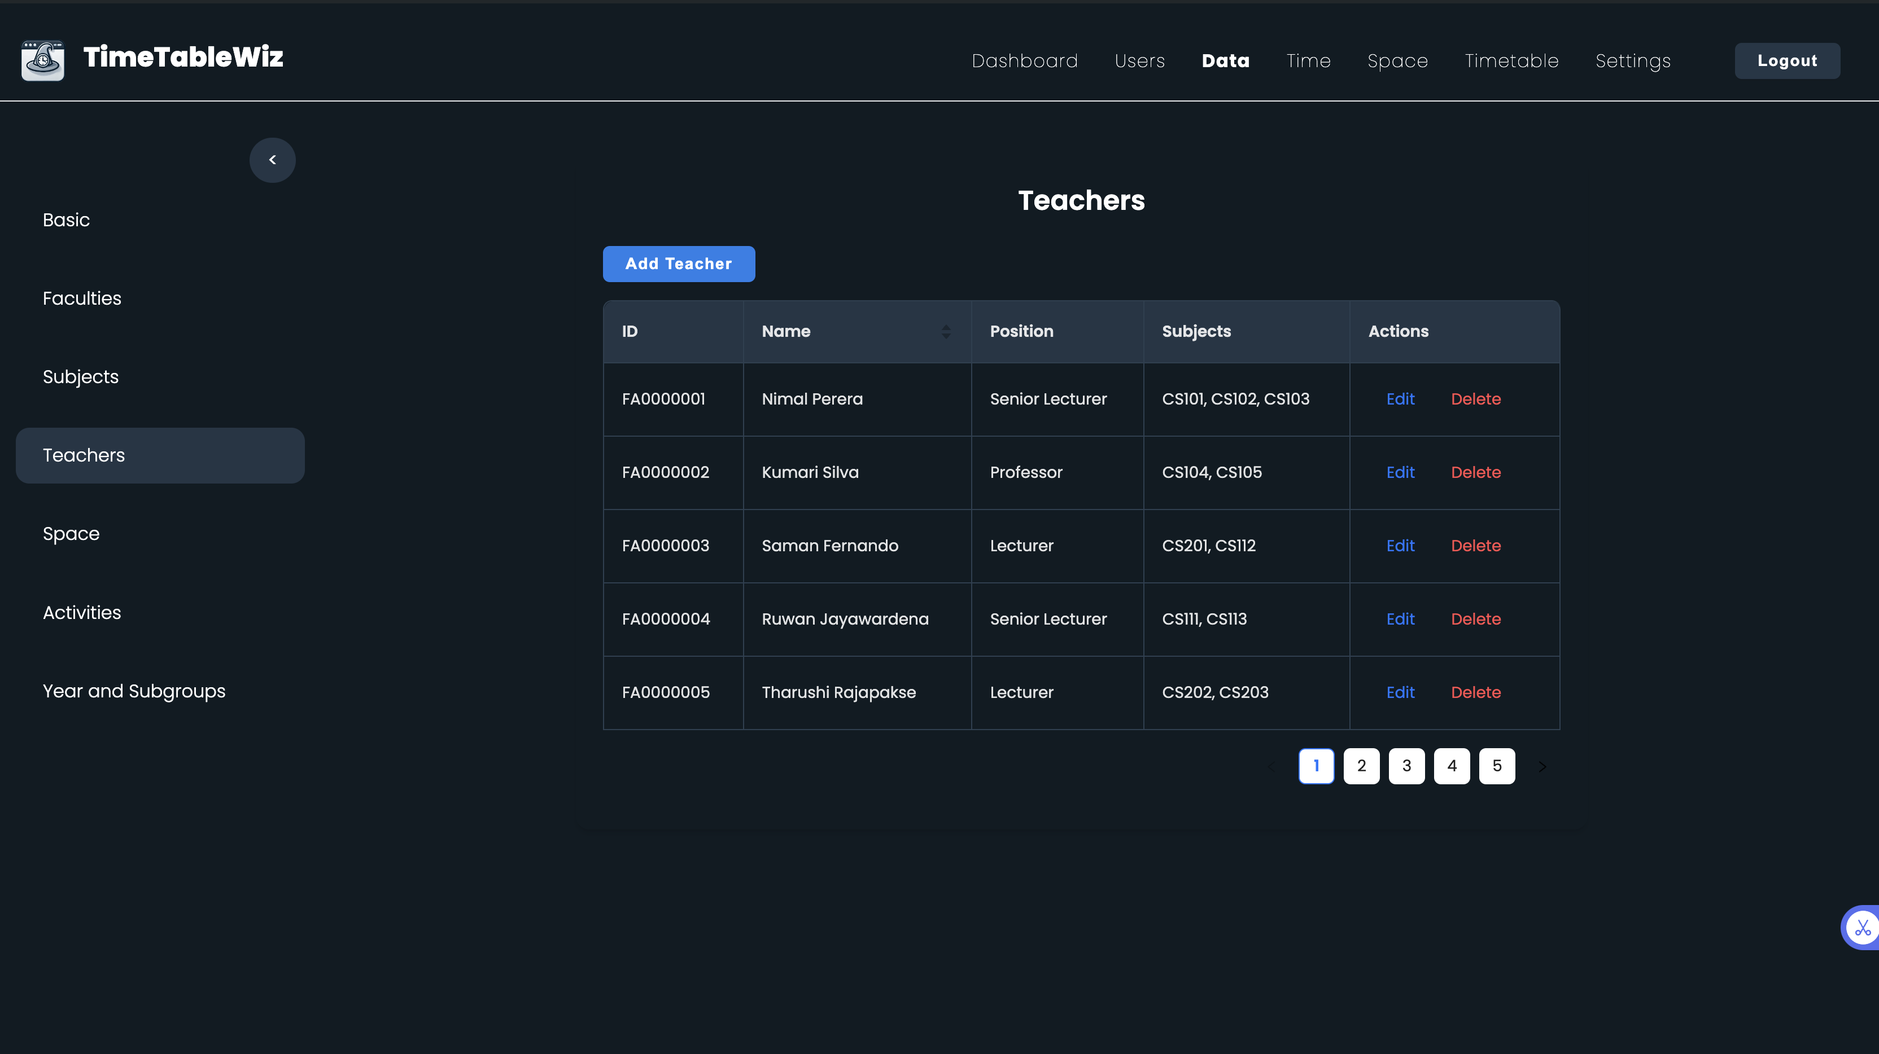
PROJECT EVIDENCE
Teachers management

Slide 76
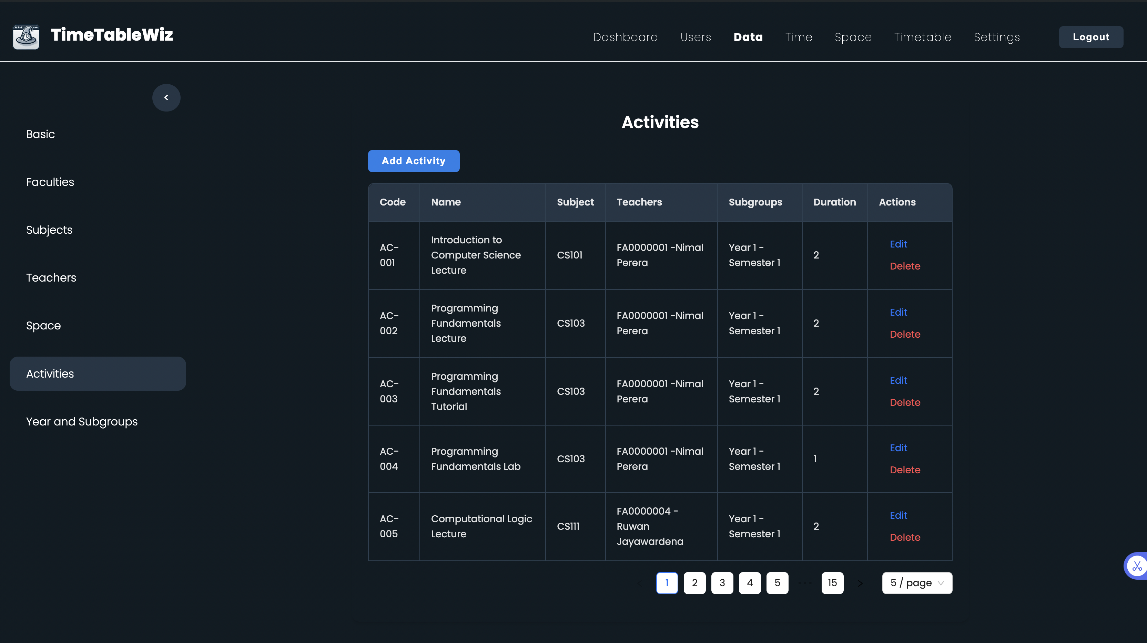
Activites management

Slide 77

Timetable evaluation score

Slide 78
REFERENCES
[1] Sahargahi, Vahideh, and Mohammadreza Feizi Drakhshi. "Comparing the methods of creating educational timetable." International Journal of Computer Science and Network Security (IJCSNS) 16.12 (2016): 26.
[2] Bashab, Abeer, et al. "Optimization Techniques in University Timetabling Problem: Constraints, Methodologies, Benchmarks, and Open Issues." Computers, Materials & Continua 74.3 (2023).
[3] Adrianto, Dennise. "Comparison using particle swarm optimization and genetic algorithm for timetable scheduling." Journal of Computer Science 10.2 (2014): 341.
[4] Mauluddin, S. Y. A. H. R. U. L., I. S. K. A. N. D. A. R. Ikbal, and A. G. U. S. Nursikuwagus. "Complexity and performance comparison of genetic algorithm and ant colony for best solution timetable class." J. Eng. Sci. Technol 15.1 (2020): 276-290.
[5]
IT21266164 | Udayantha D.M.S | 24-25J-238

Slide 79
COMMERCIALIZATION
Introduce as a Subscription Service for Timetable Generation in state and Non state universities in Sri Lanka
In Further Steps introduce into School Systems in Sri Lanka in a version II
Expand beyond Educational Realm where Scheduling considered key component in industry

Slide 80
RISK MITIGATION
Schedule regular meetings with the supervisor to stay on track and solve issues quickly.
Use GitHub for version control to efficiently manage, track, and collaborate on code changes.
Leverage project management tools like jira and Planner for better organization.
Develop risk mitigation strategies to minimize problems and ensure successful project completion

Slide 81
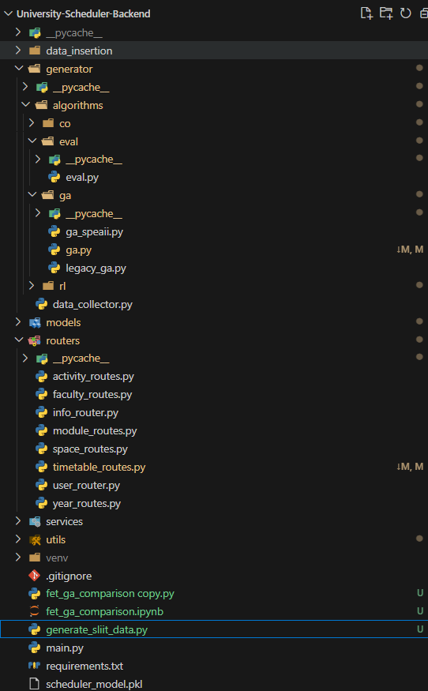
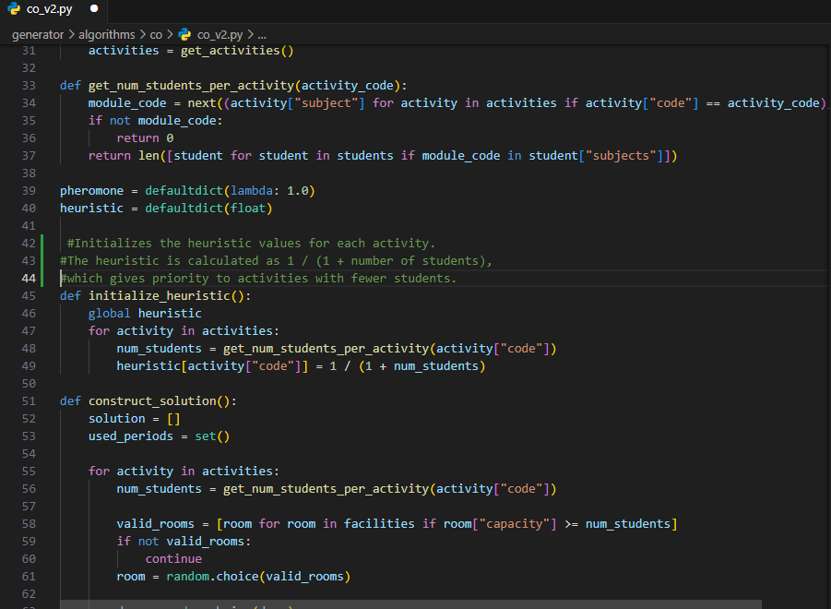
Best Practices Followed
Clear separation of concerns
Modular architecture
Follows Python package structure
Added comments explaining each part

Slide 82

DEMO TIME

Slide 83


